Slide 1
CS 240 Week 2 Summer Semester

Slide 2
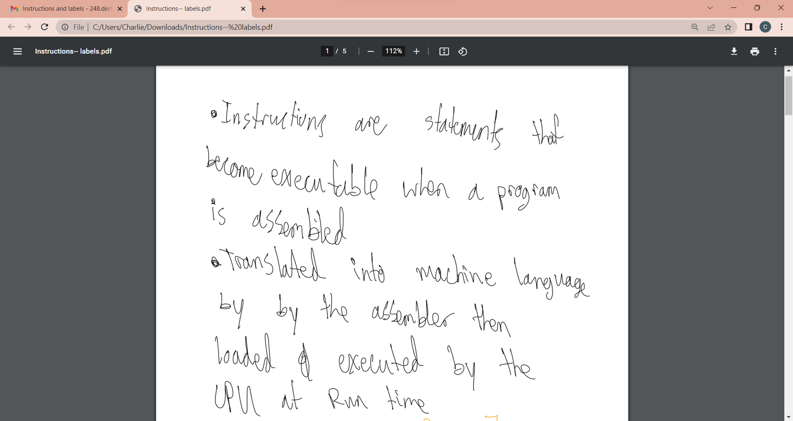
Instructions and Labels

Slide 3
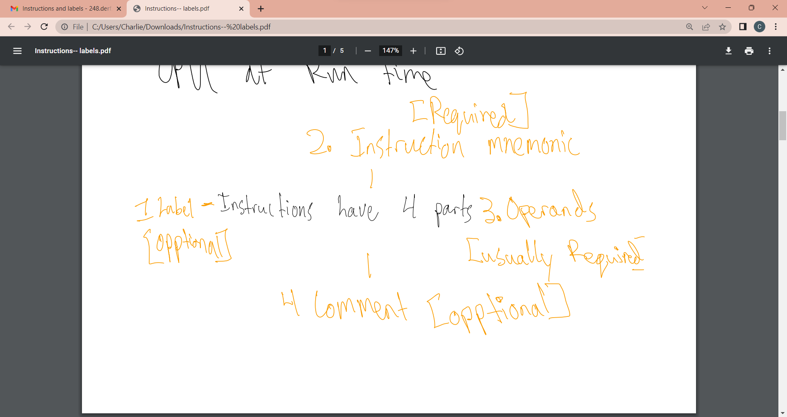

Slide 4
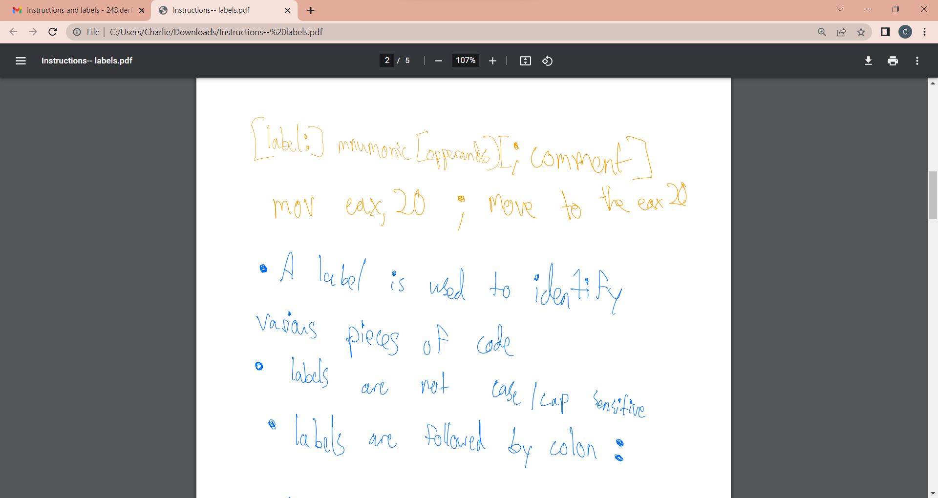

Slide 5
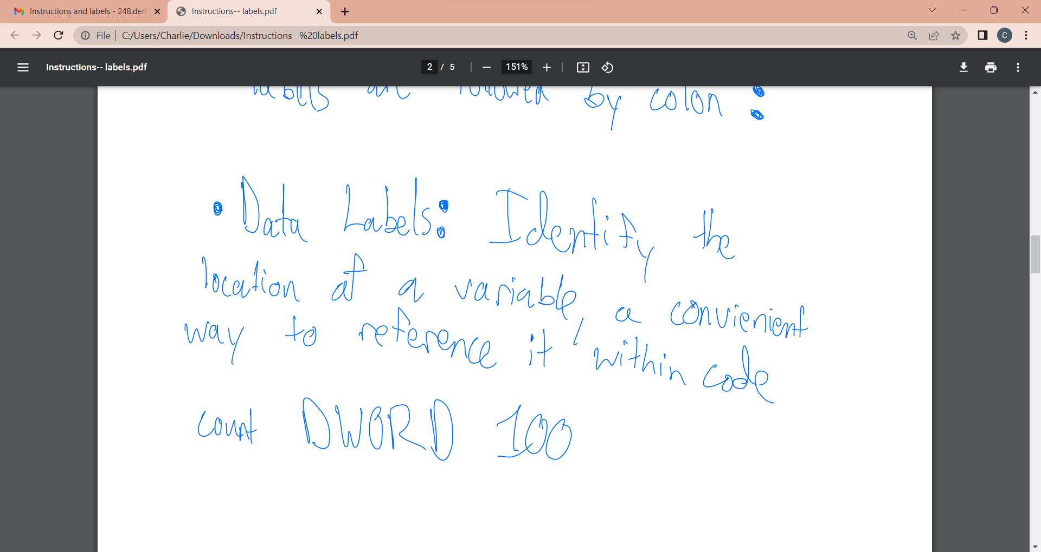

Slide 6
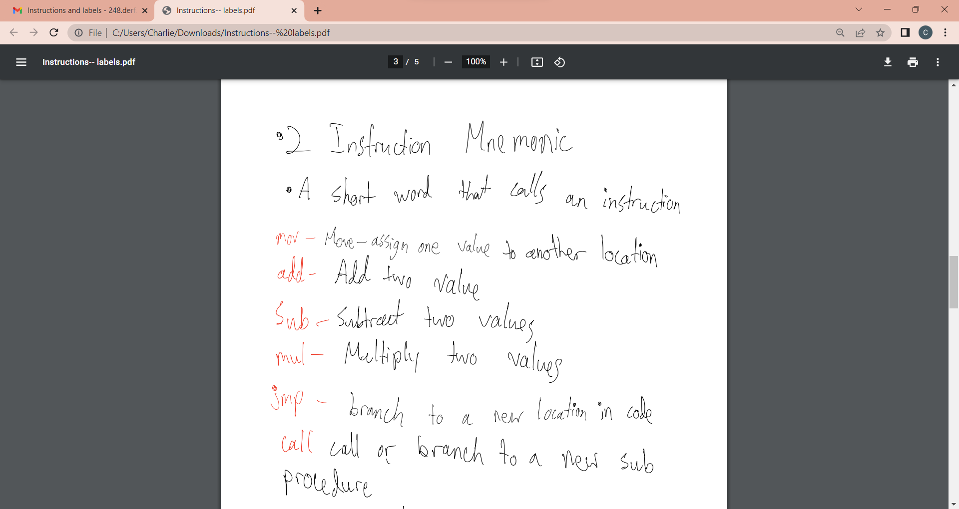

Slide 7
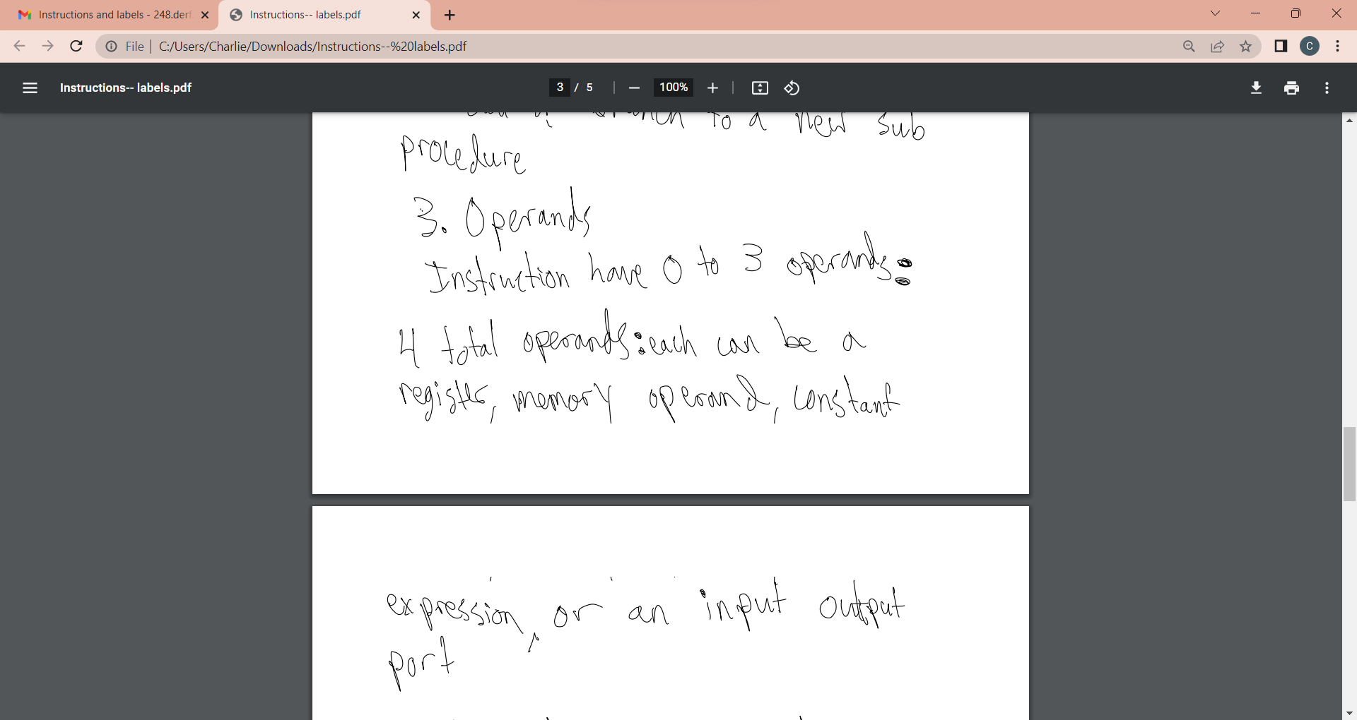

Slide 8
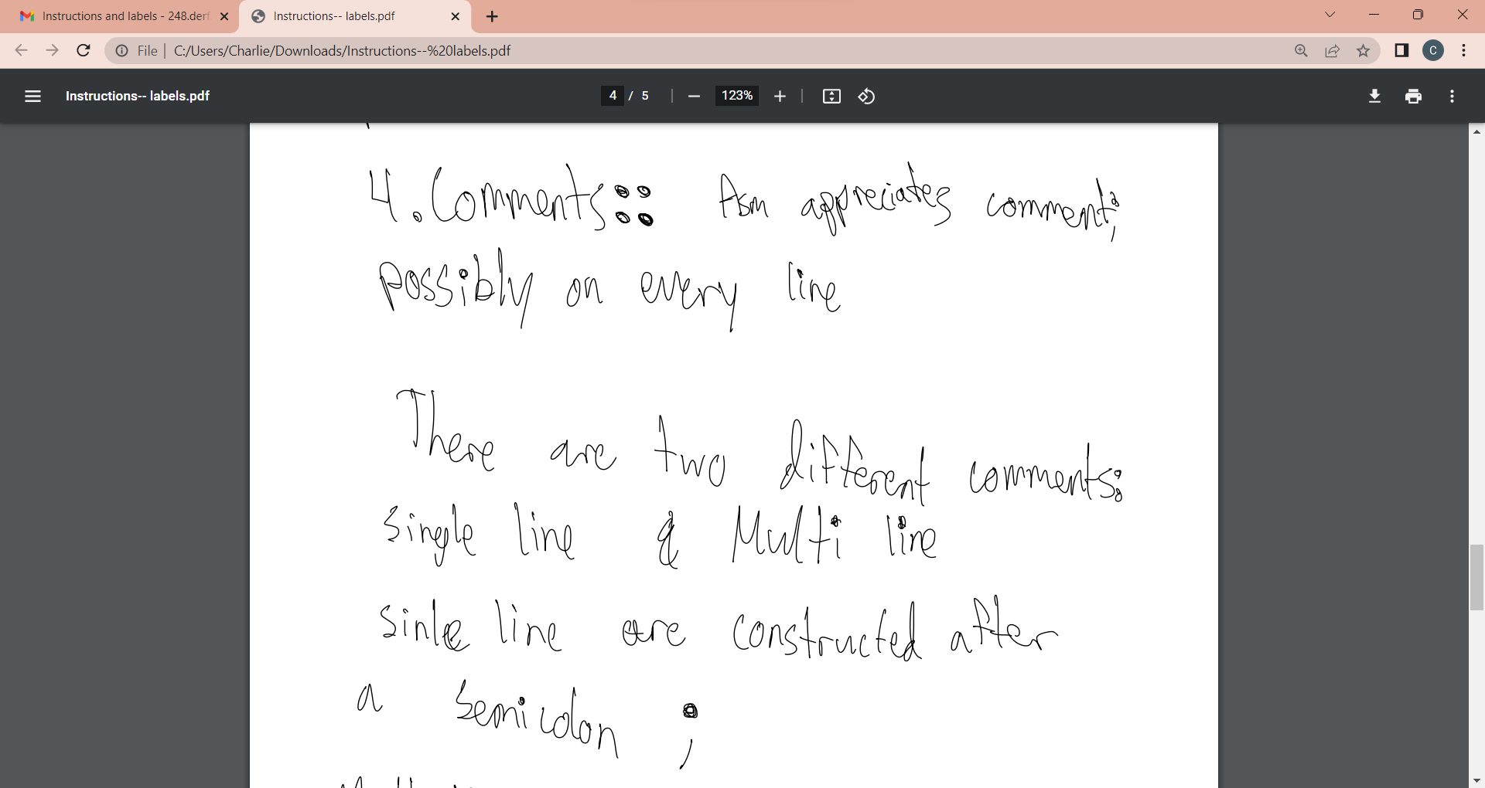

Slide 9
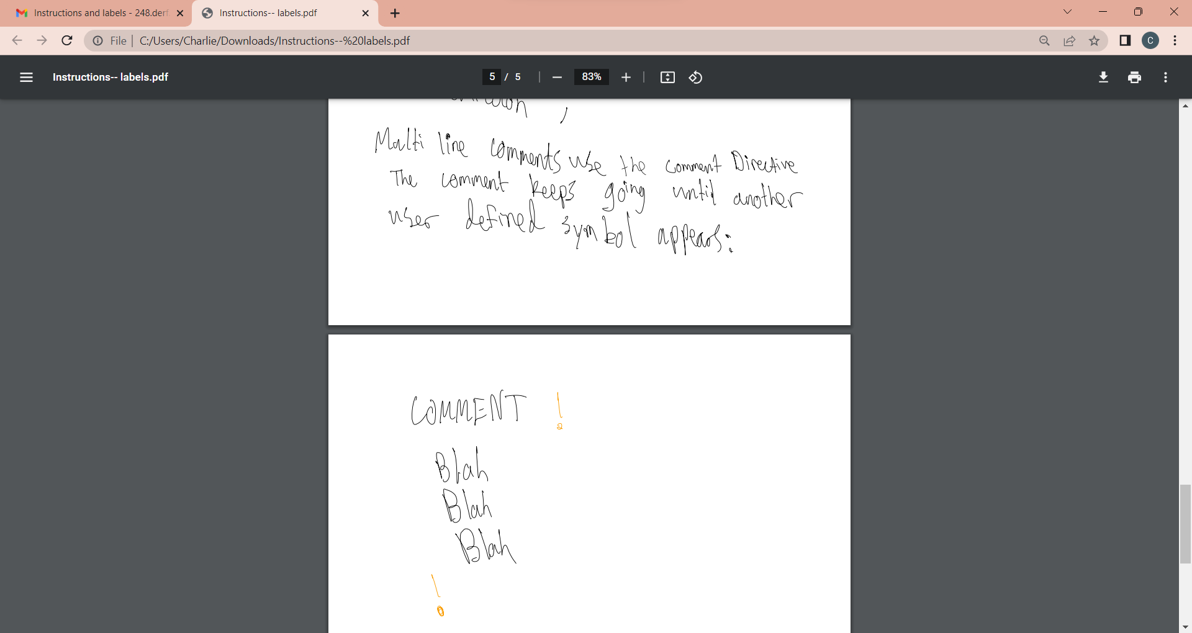

Slide 10
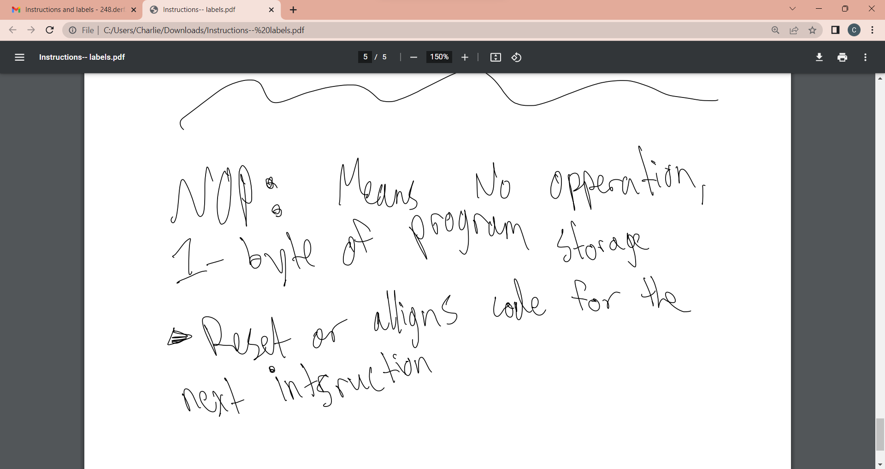

Slide 11



Slide 12
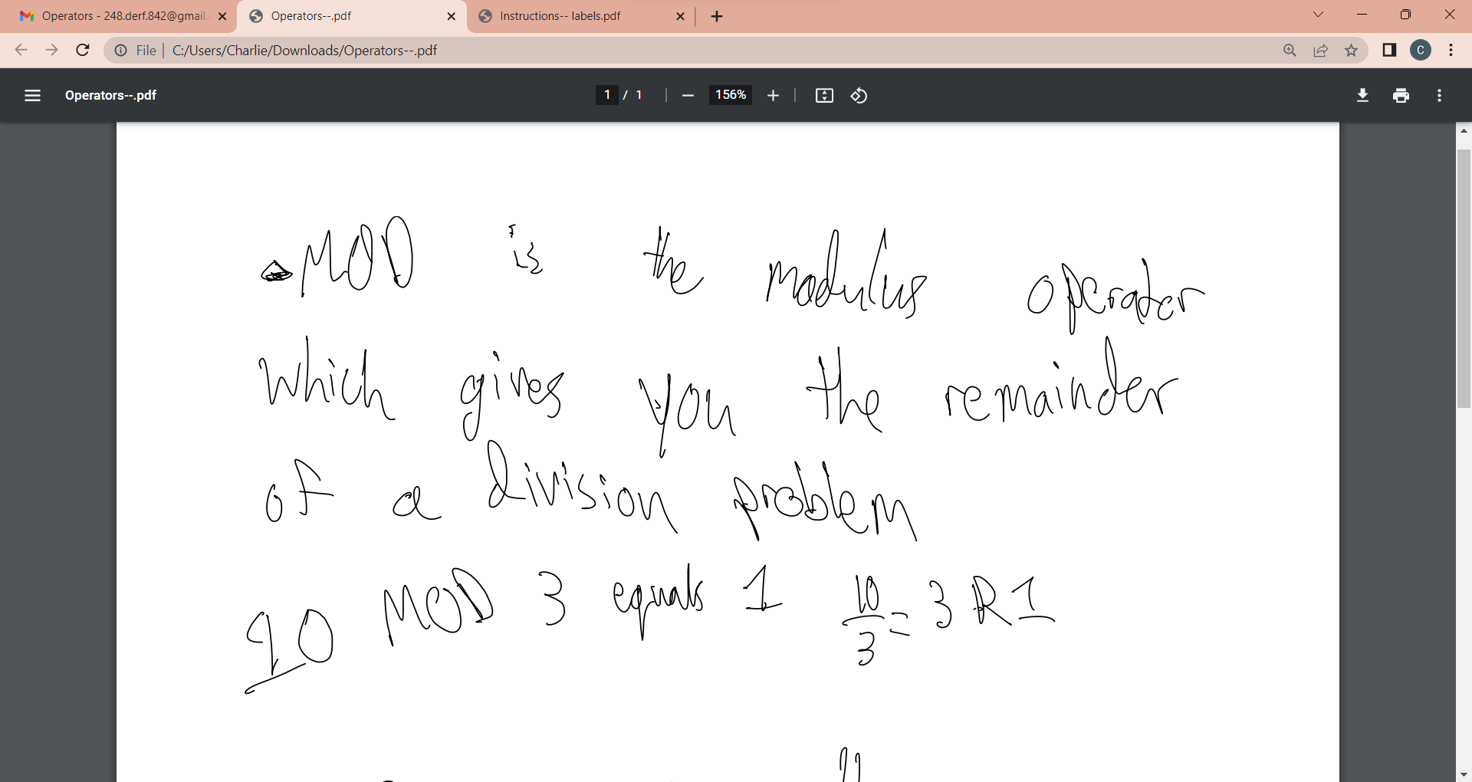
DUP Operators

Slide 13
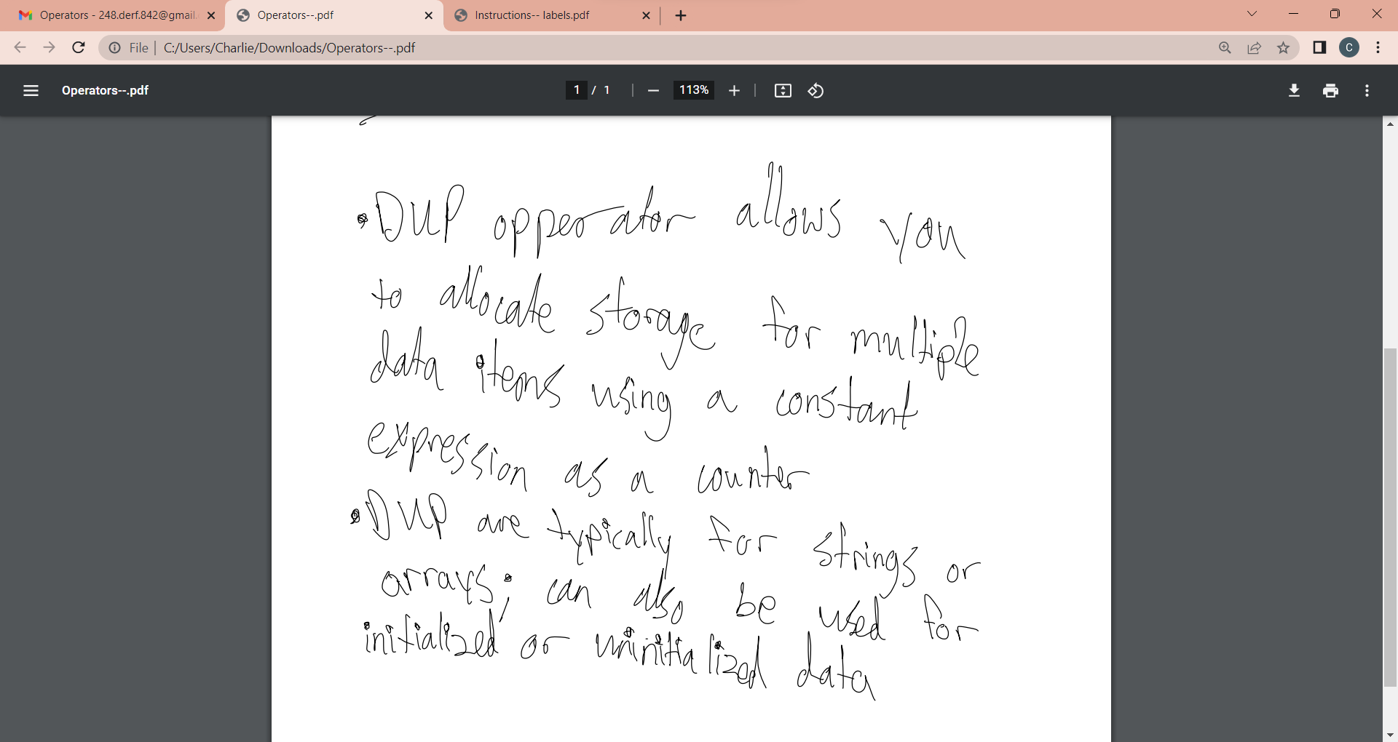

Slide 14
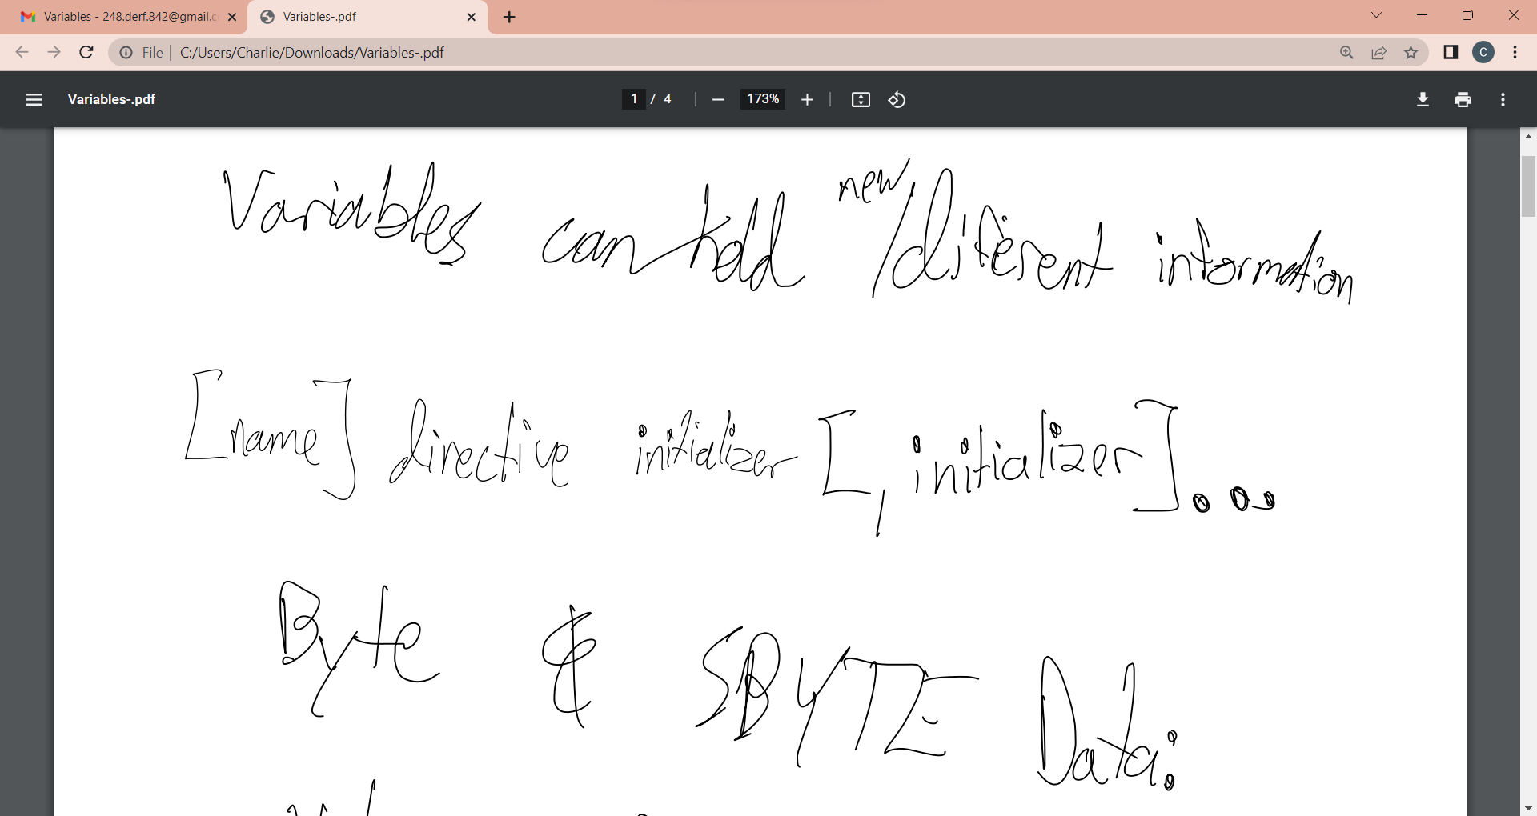
Variables

Slide 15
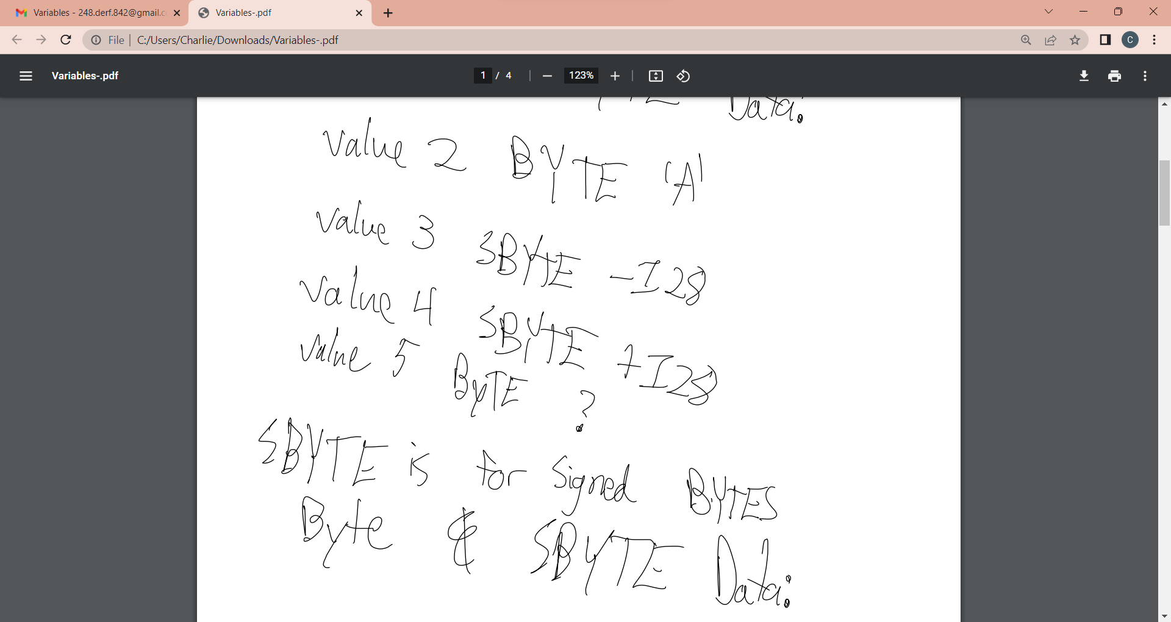

Slide 16
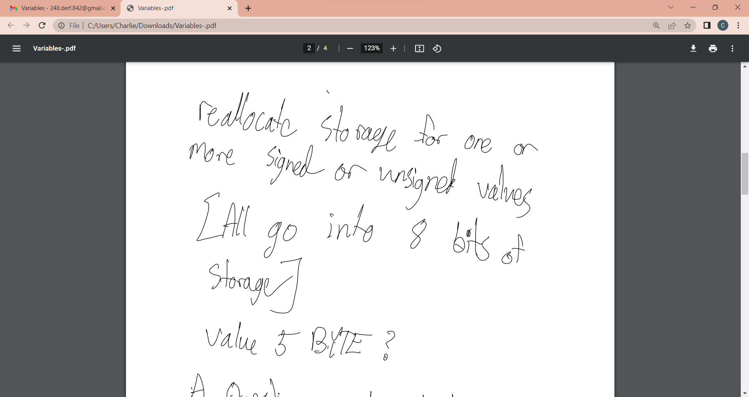

Slide 17
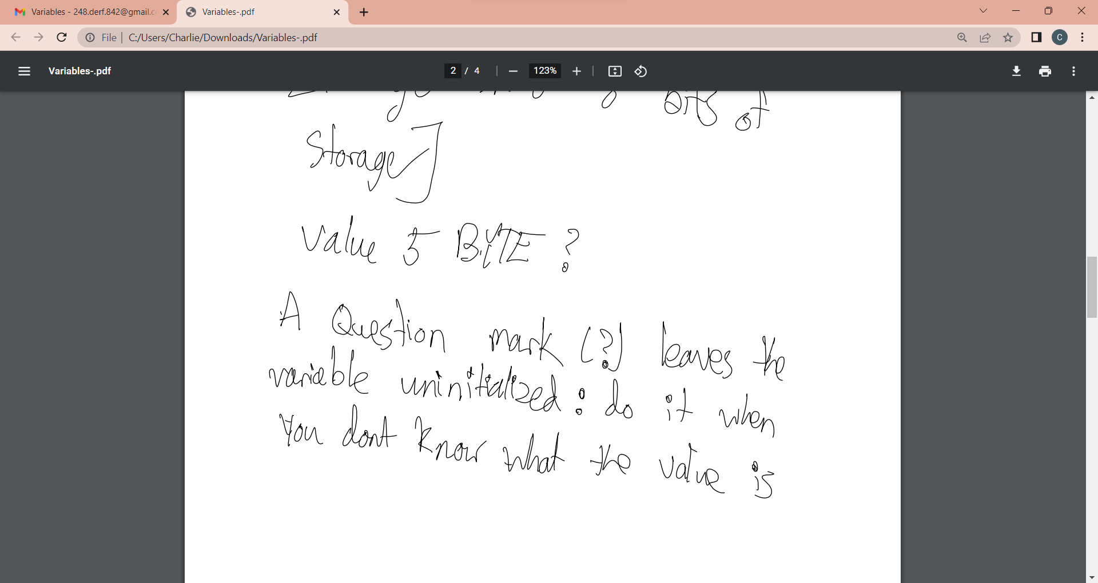

Slide 18
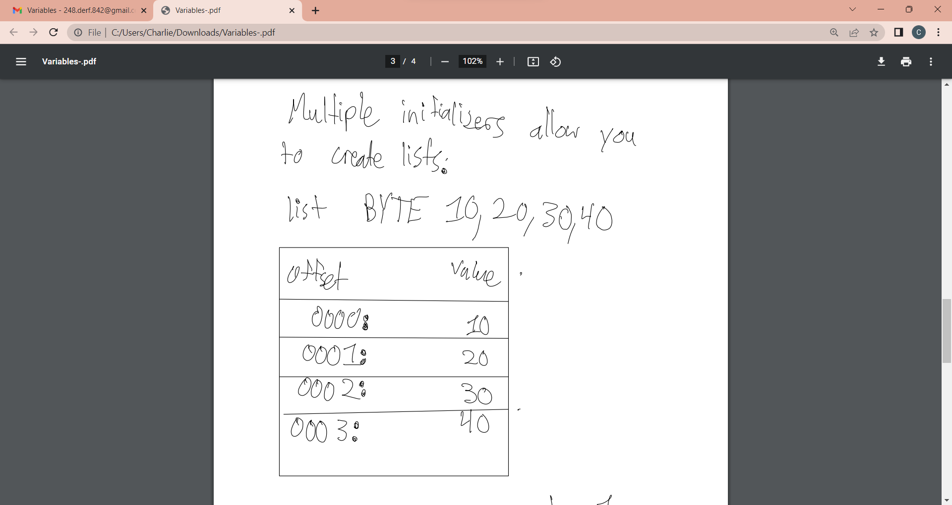

Slide 19
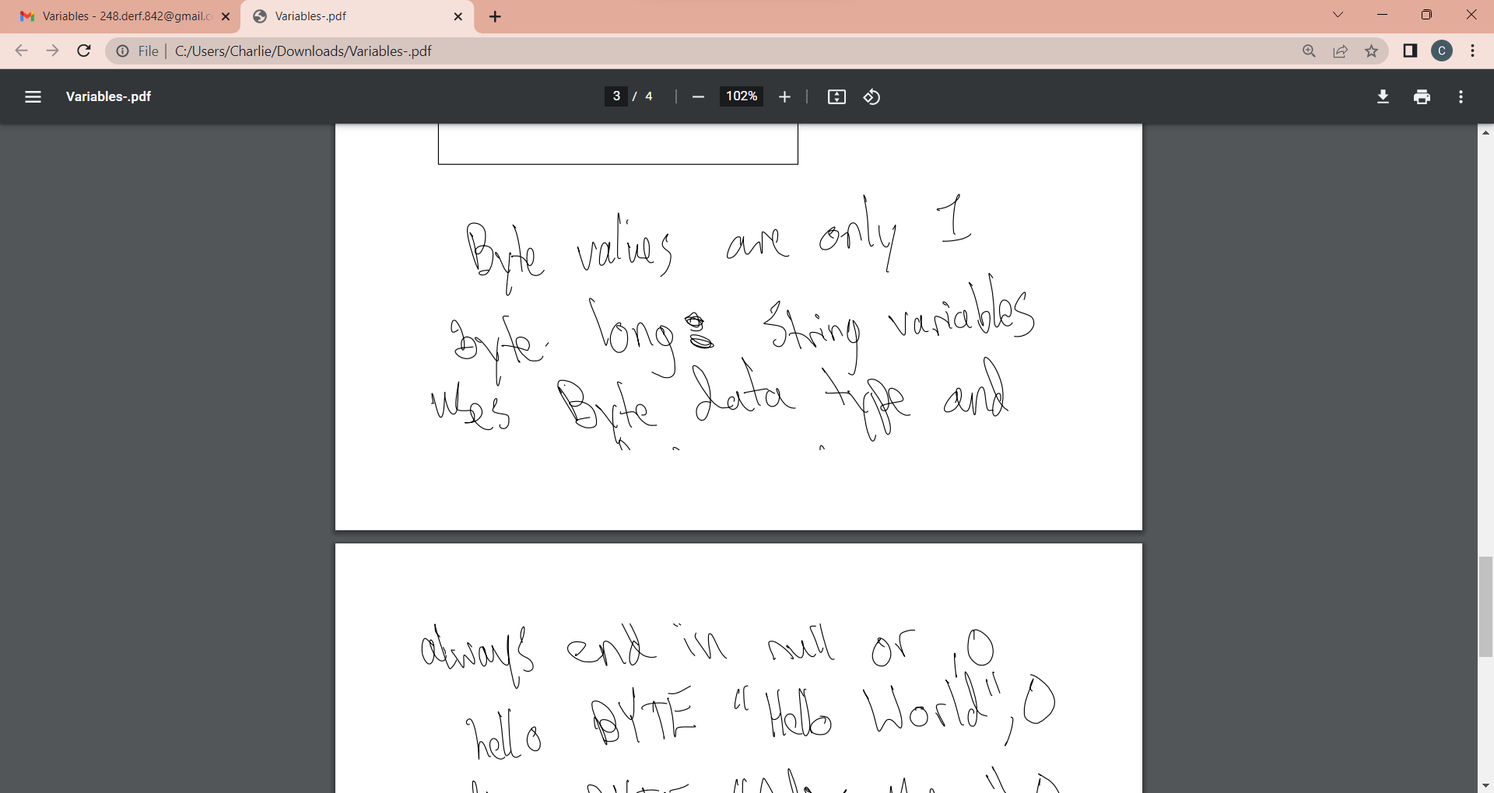

Slide 20
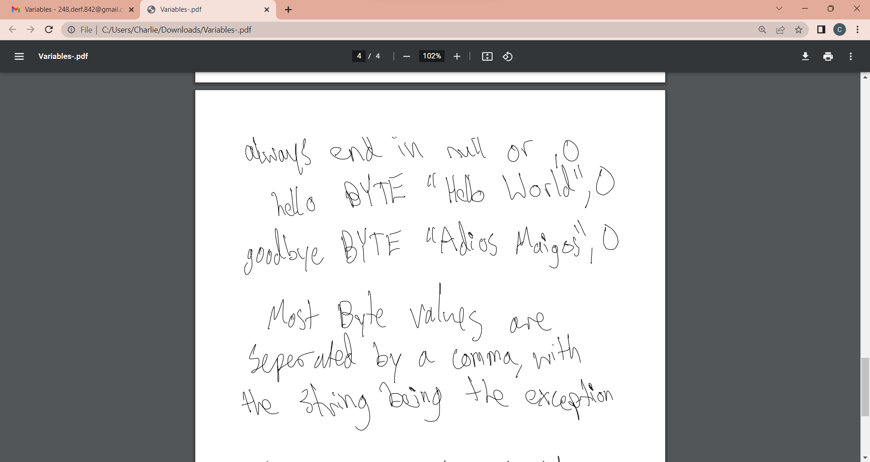

Slide 21
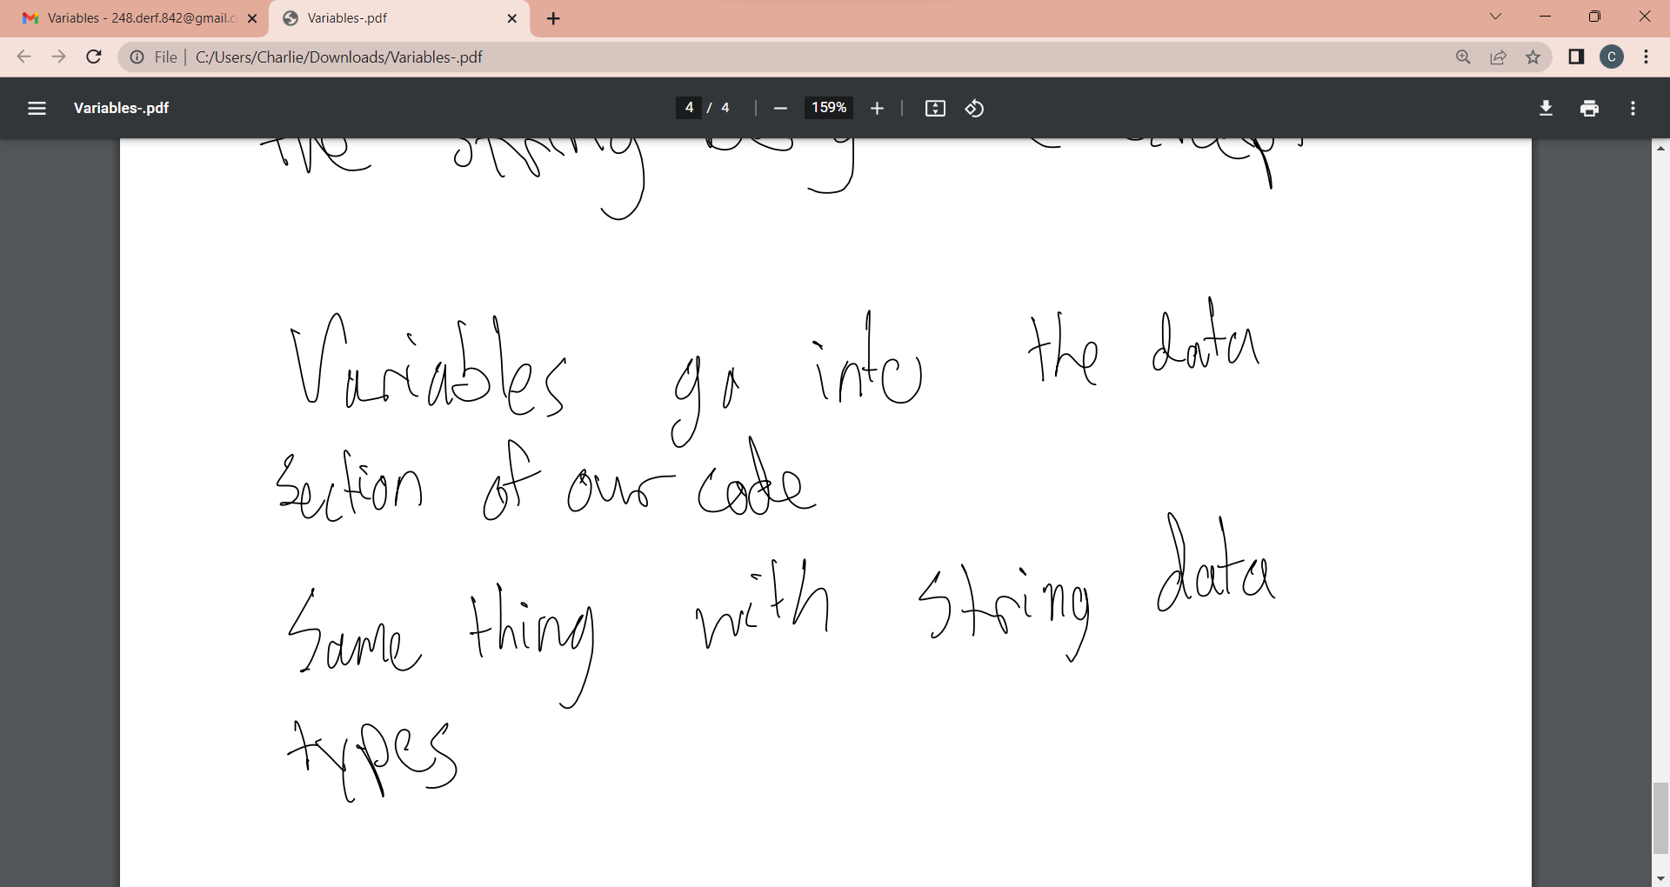

Slide 22


Slide 23
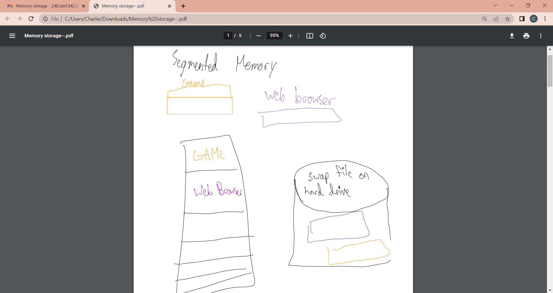
Memory Storage

Slide 24
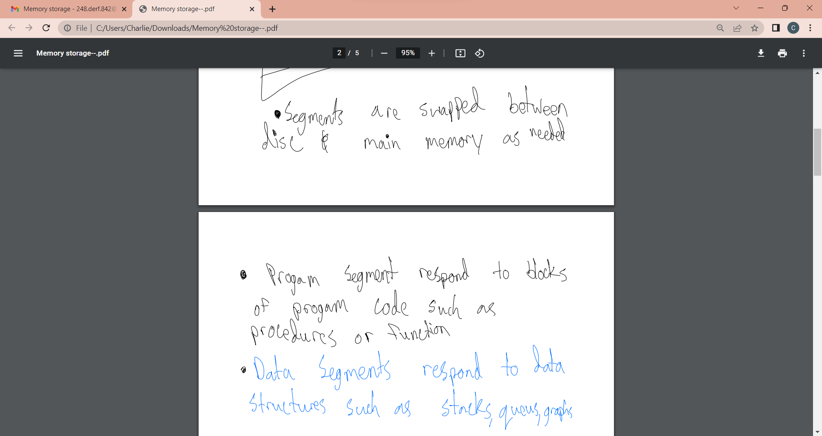

Slide 25
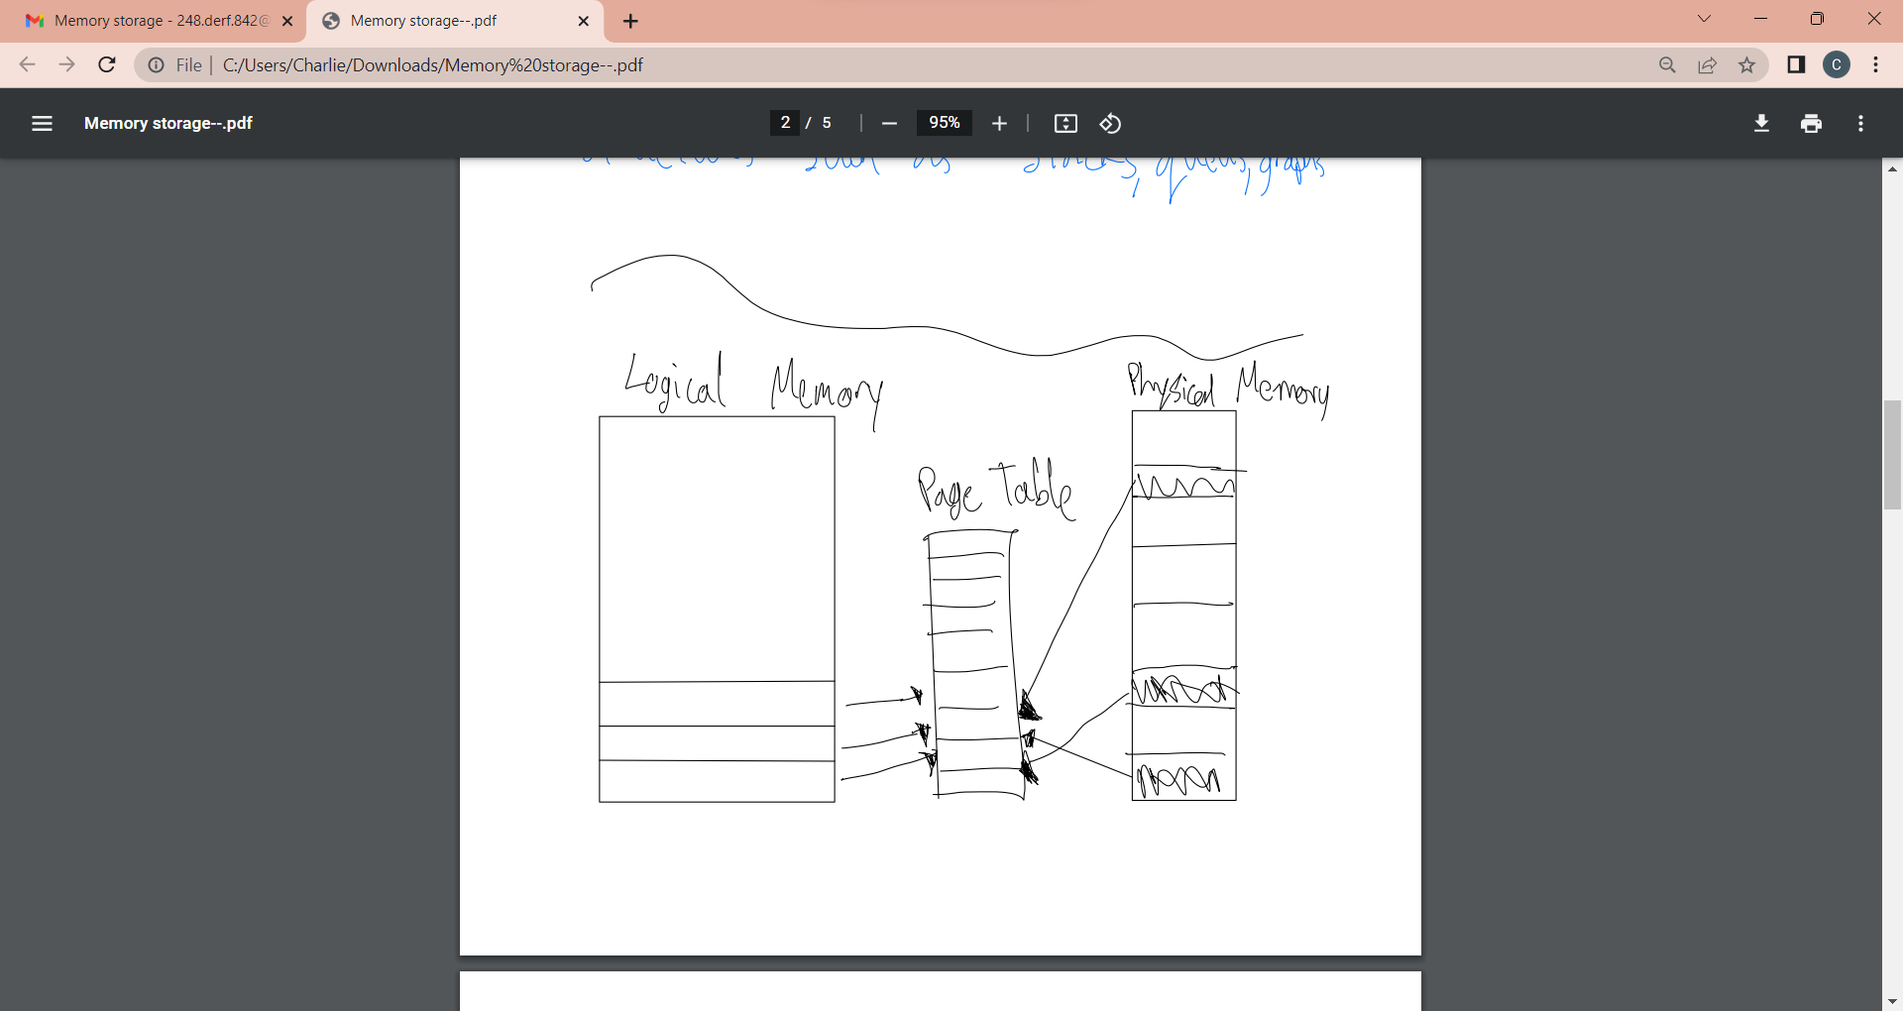

Slide 26
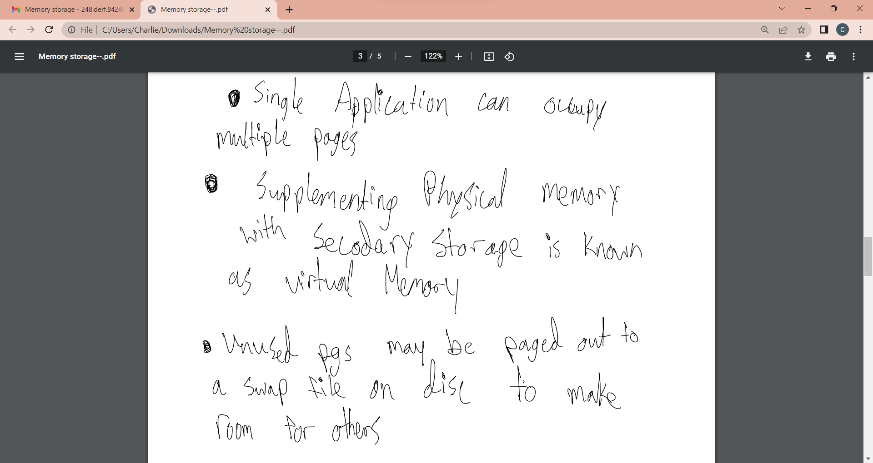

Slide 27
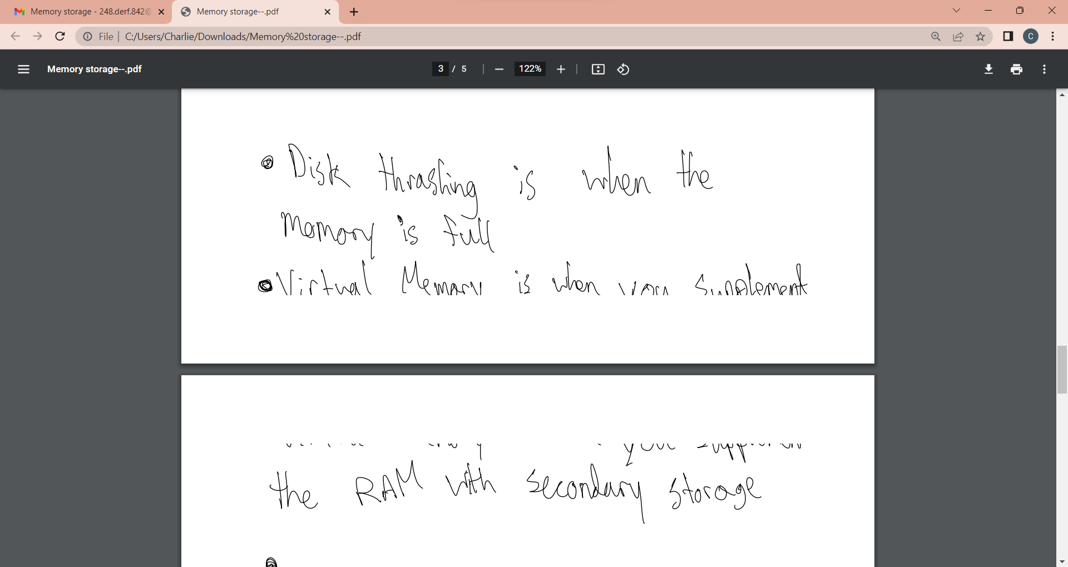

Slide 28
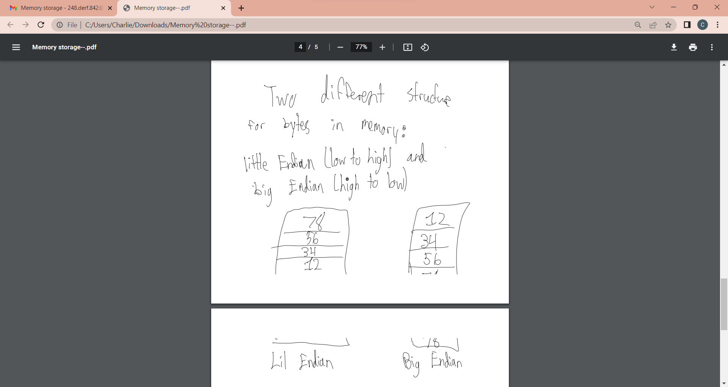

Slide 29
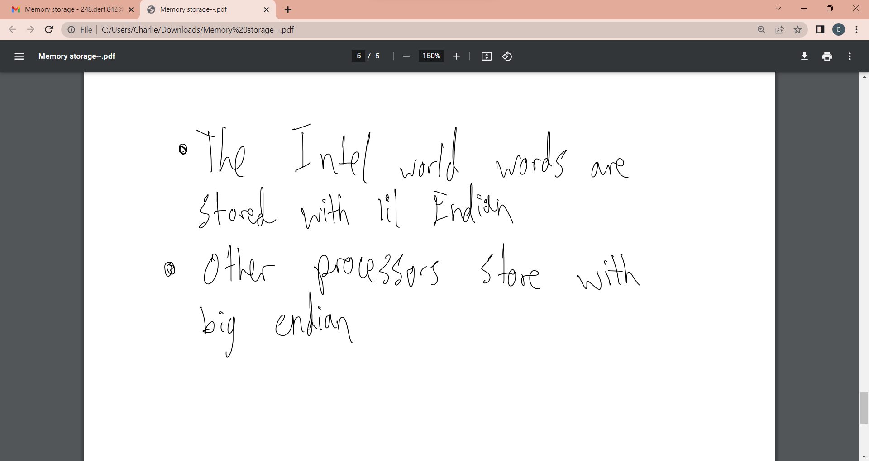

Slide 30



Slide 31
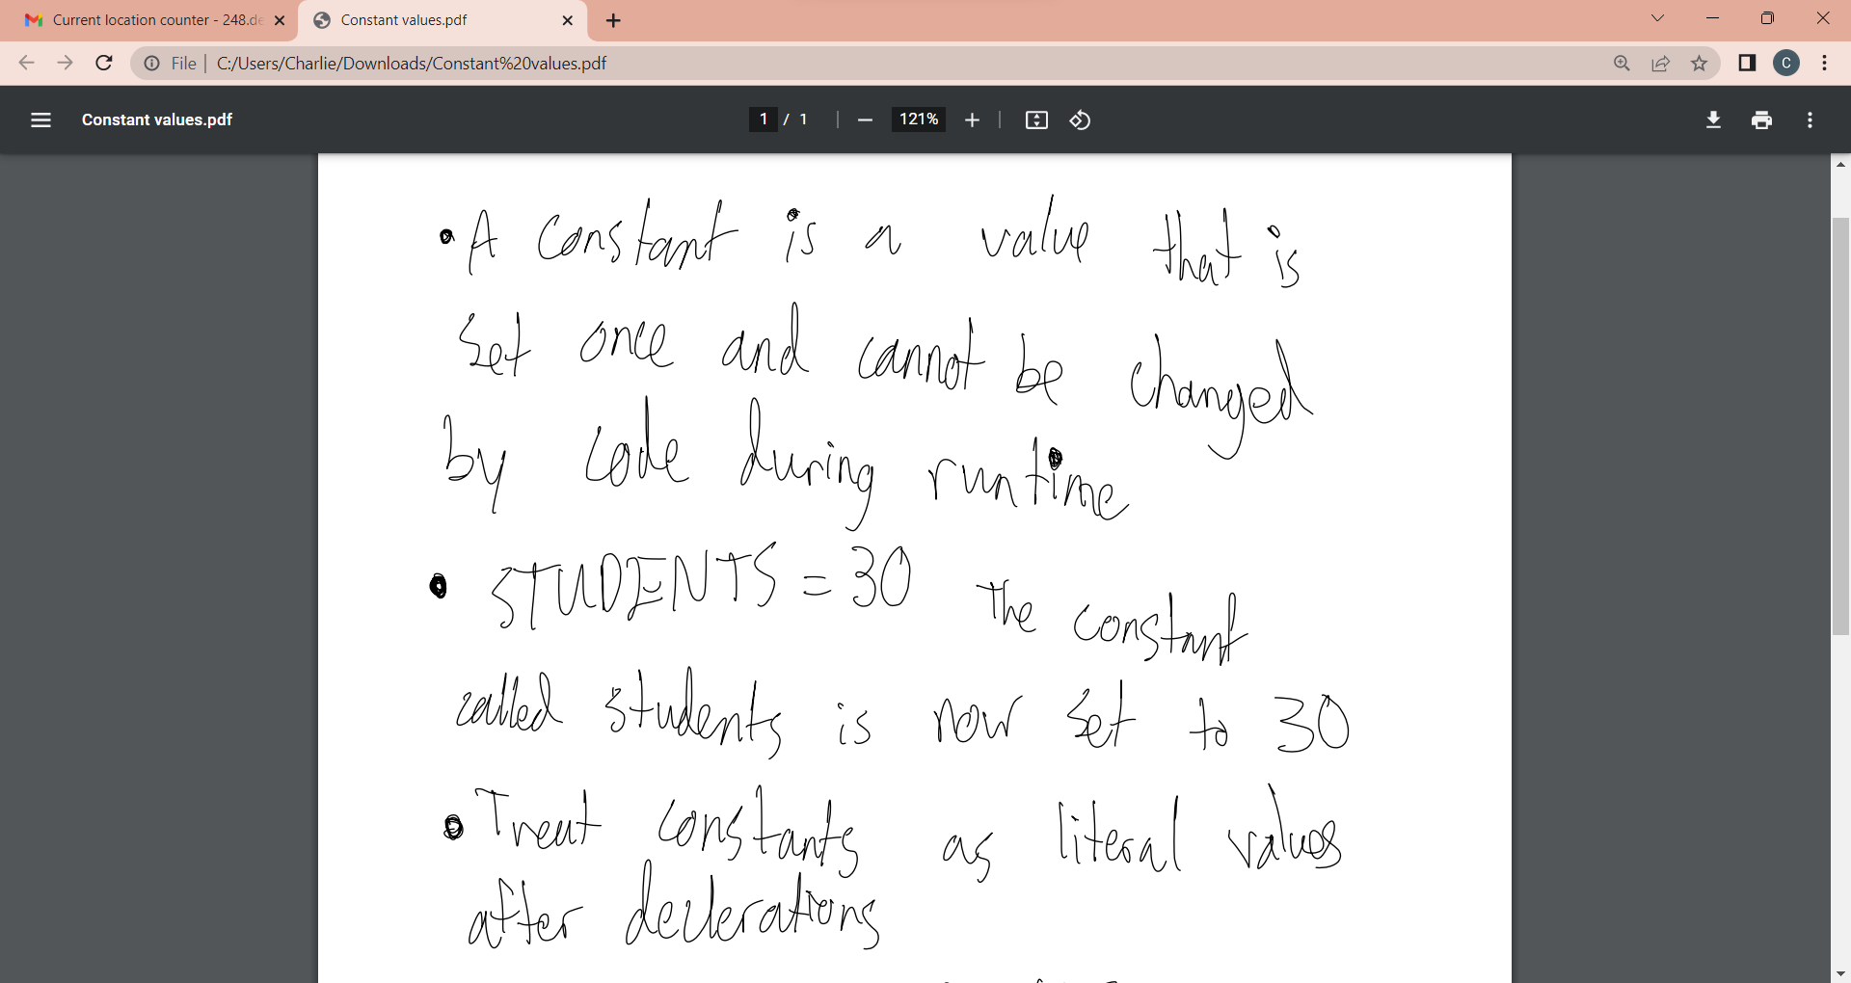
Constant Values

Slide 32
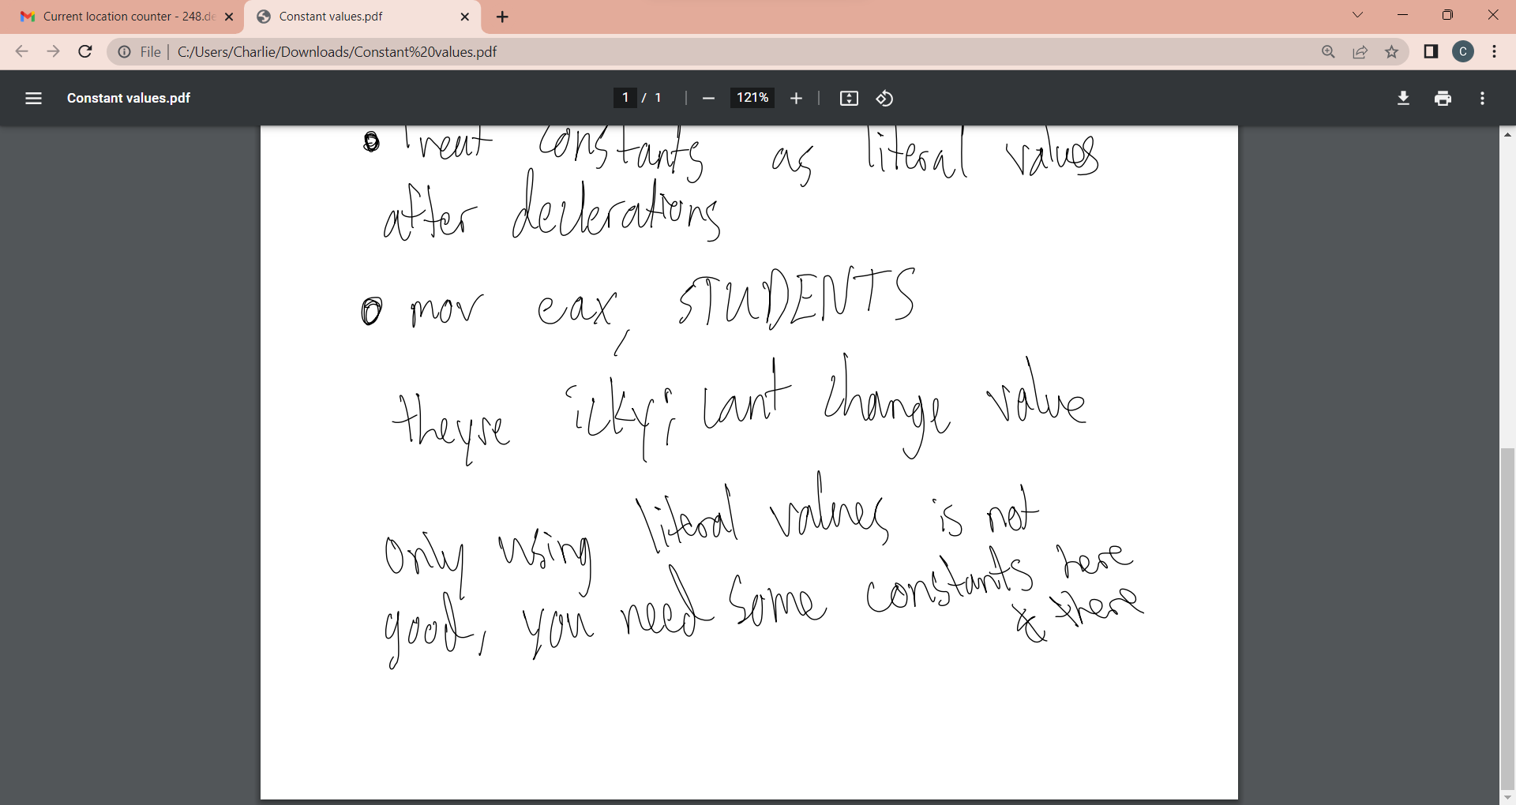

Slide 33
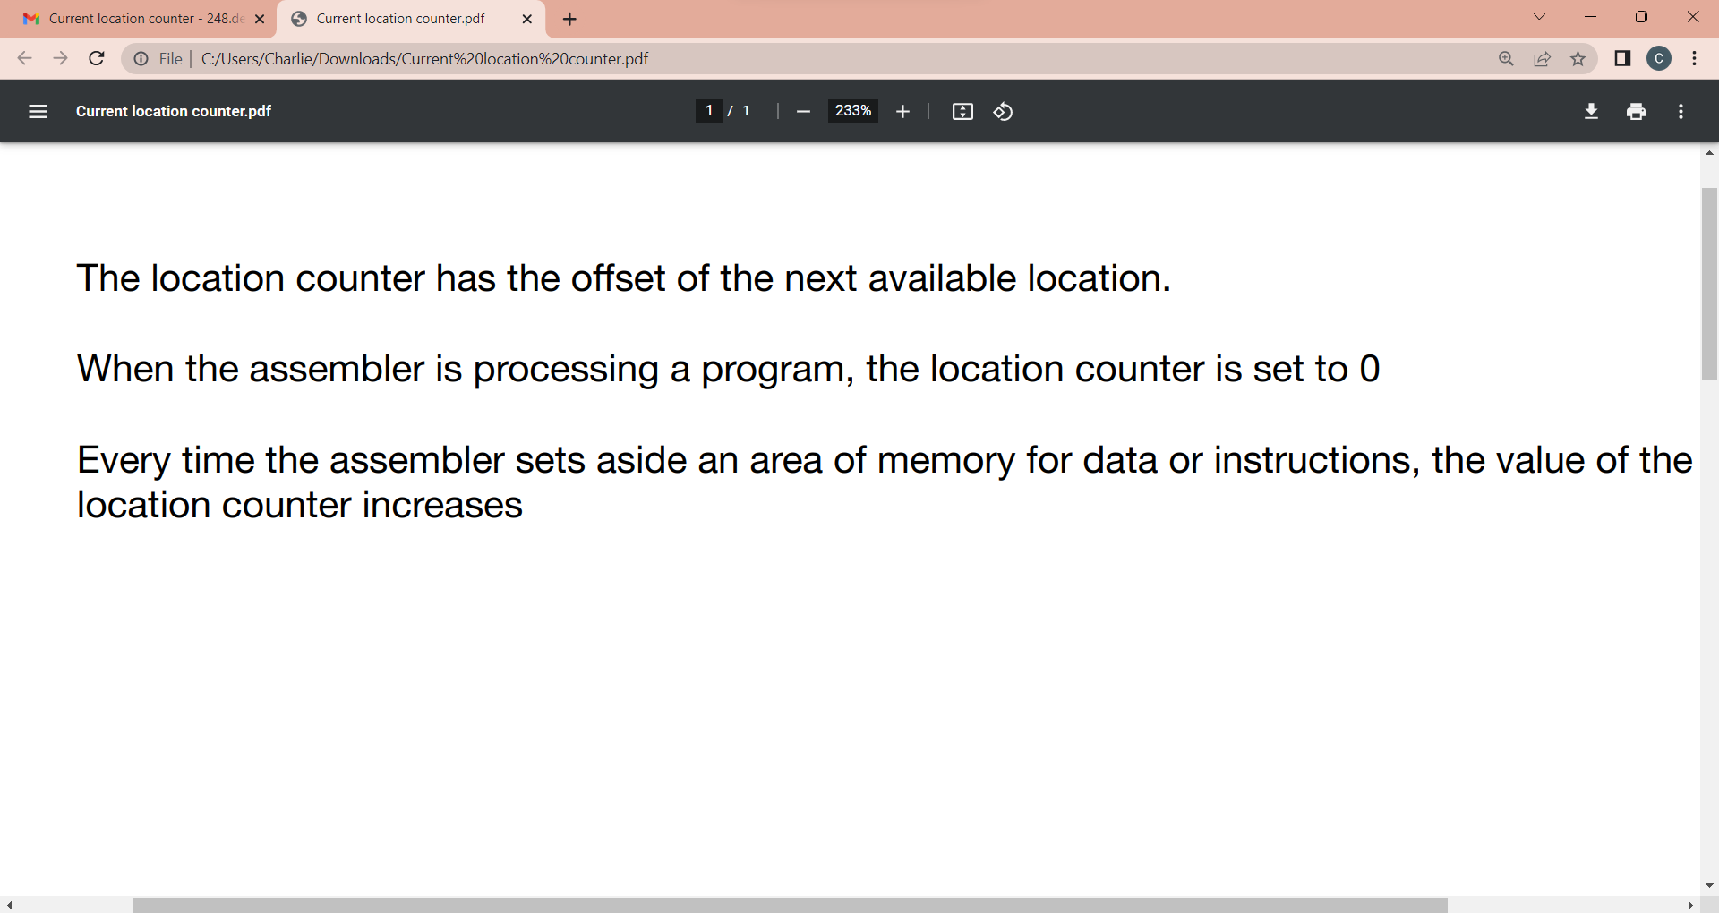

Slide 34
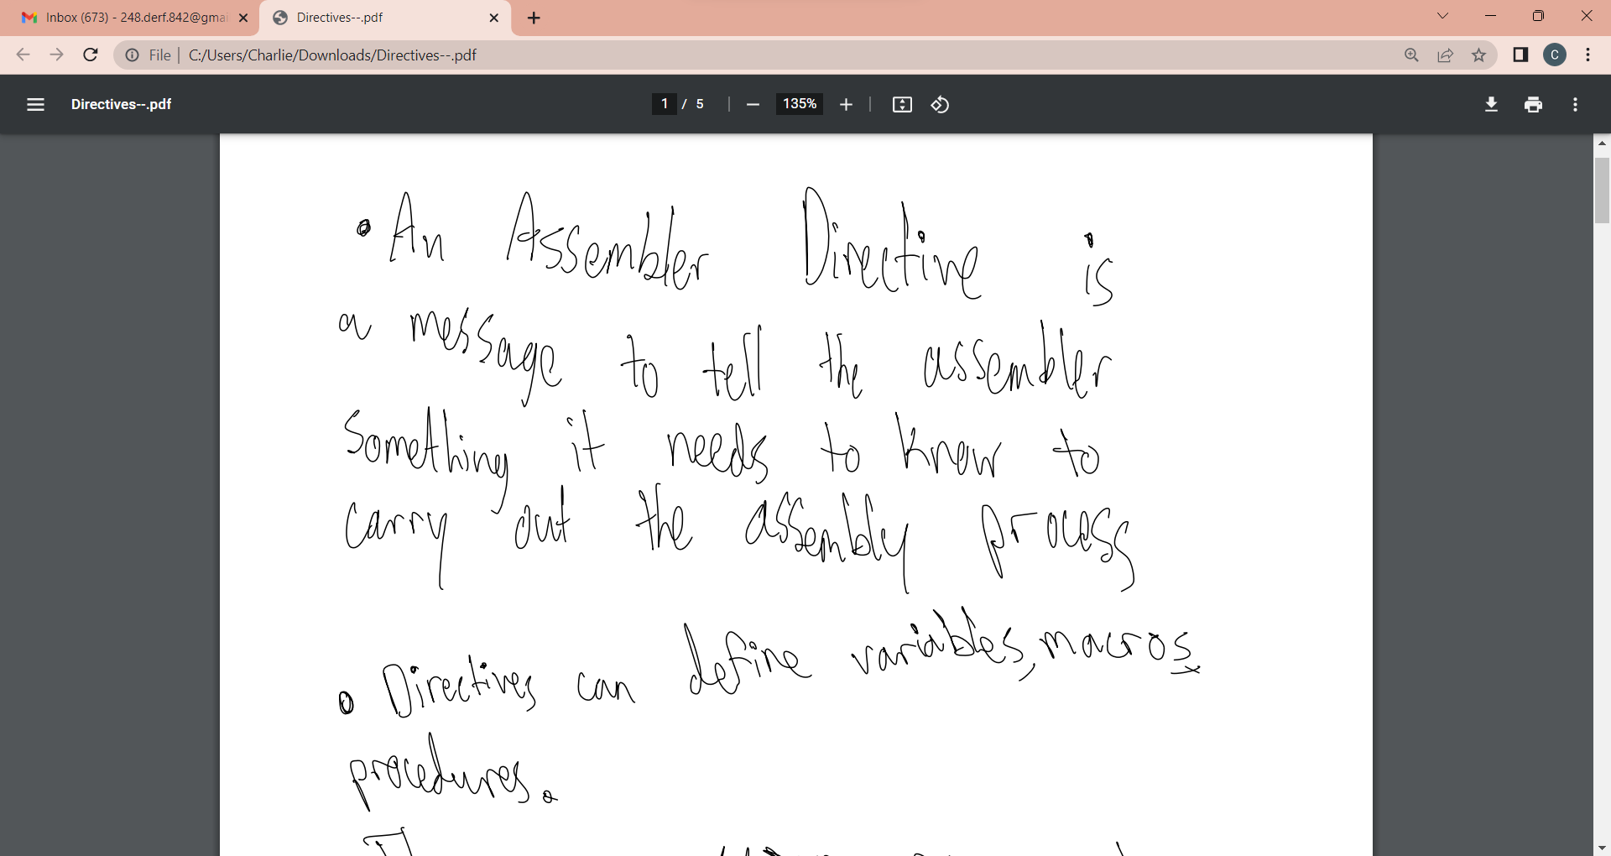
Directives

Slide 35
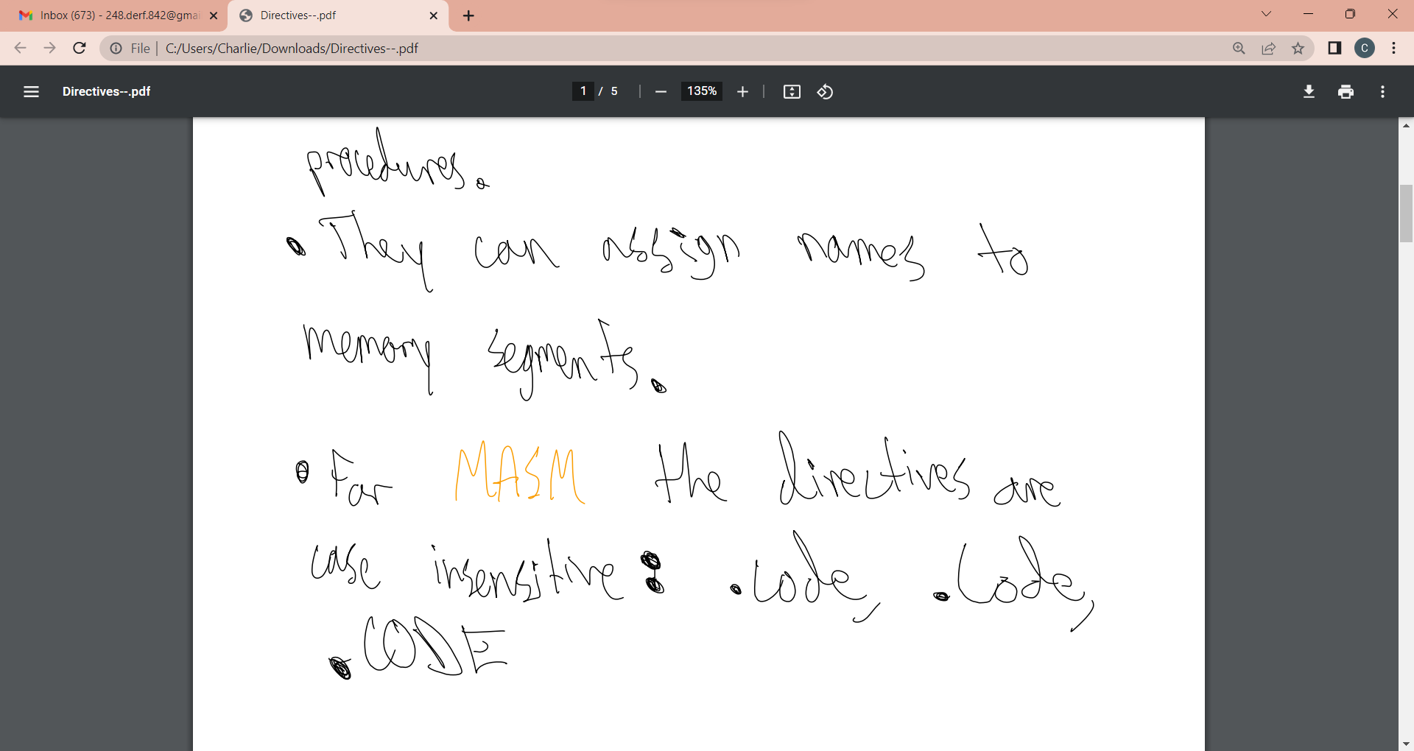

Slide 36
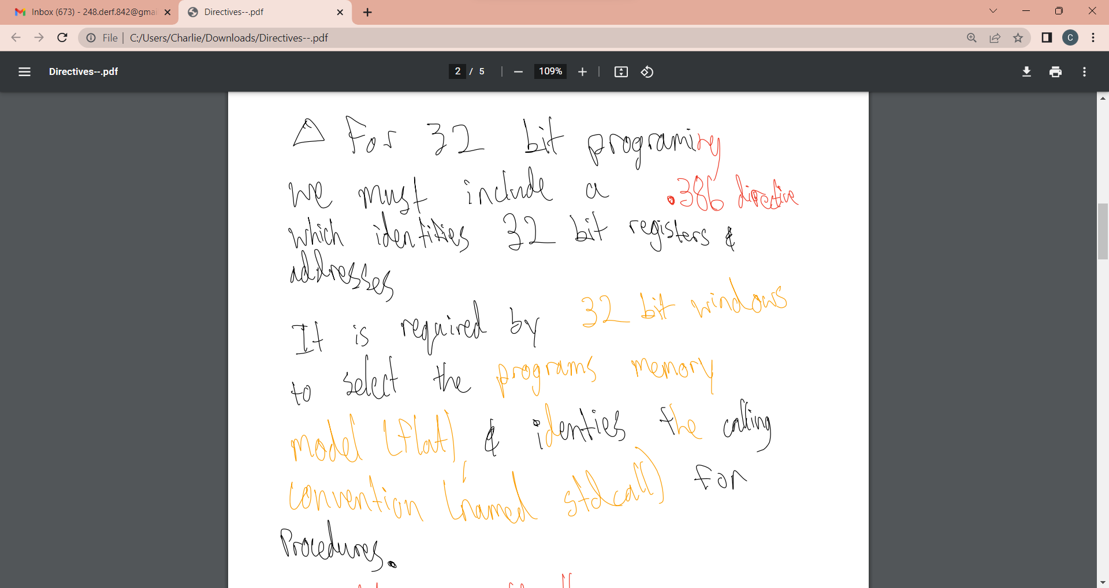

Slide 37
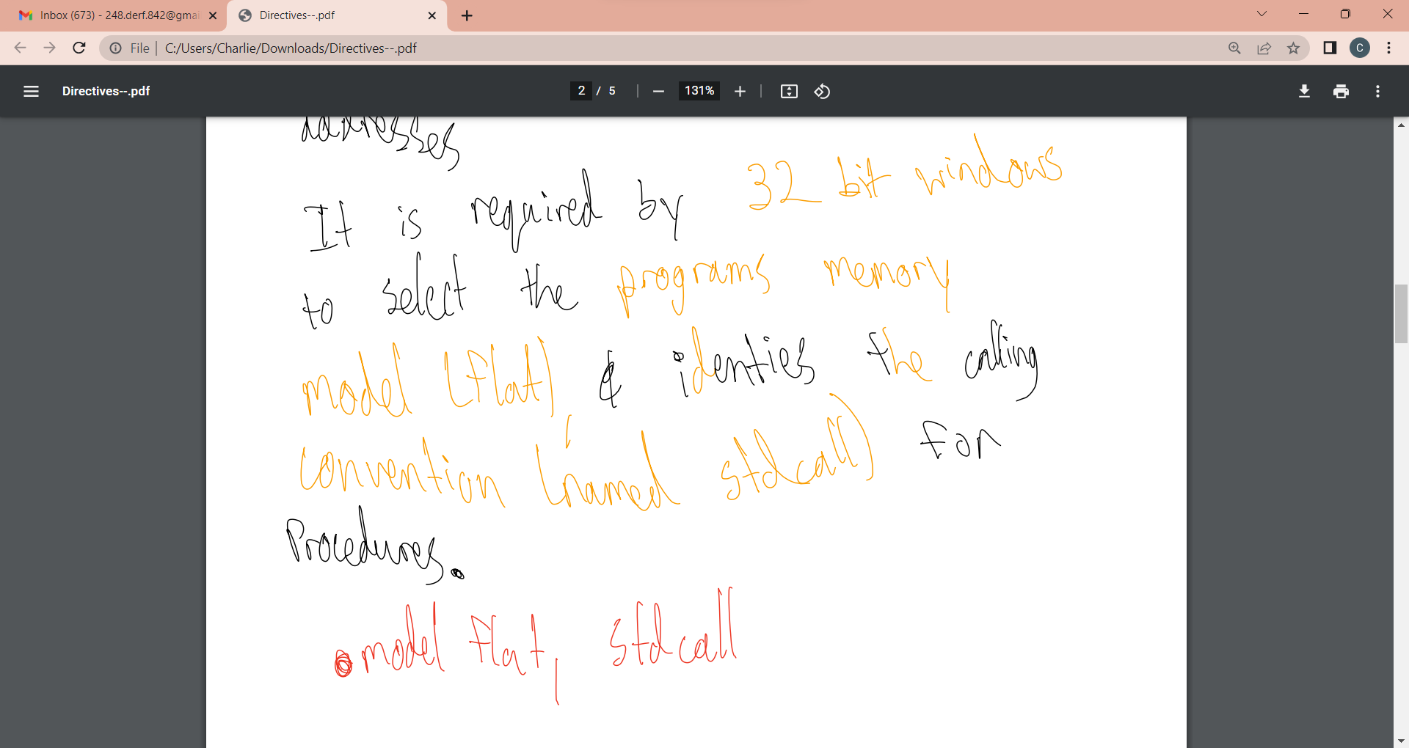

Slide 38
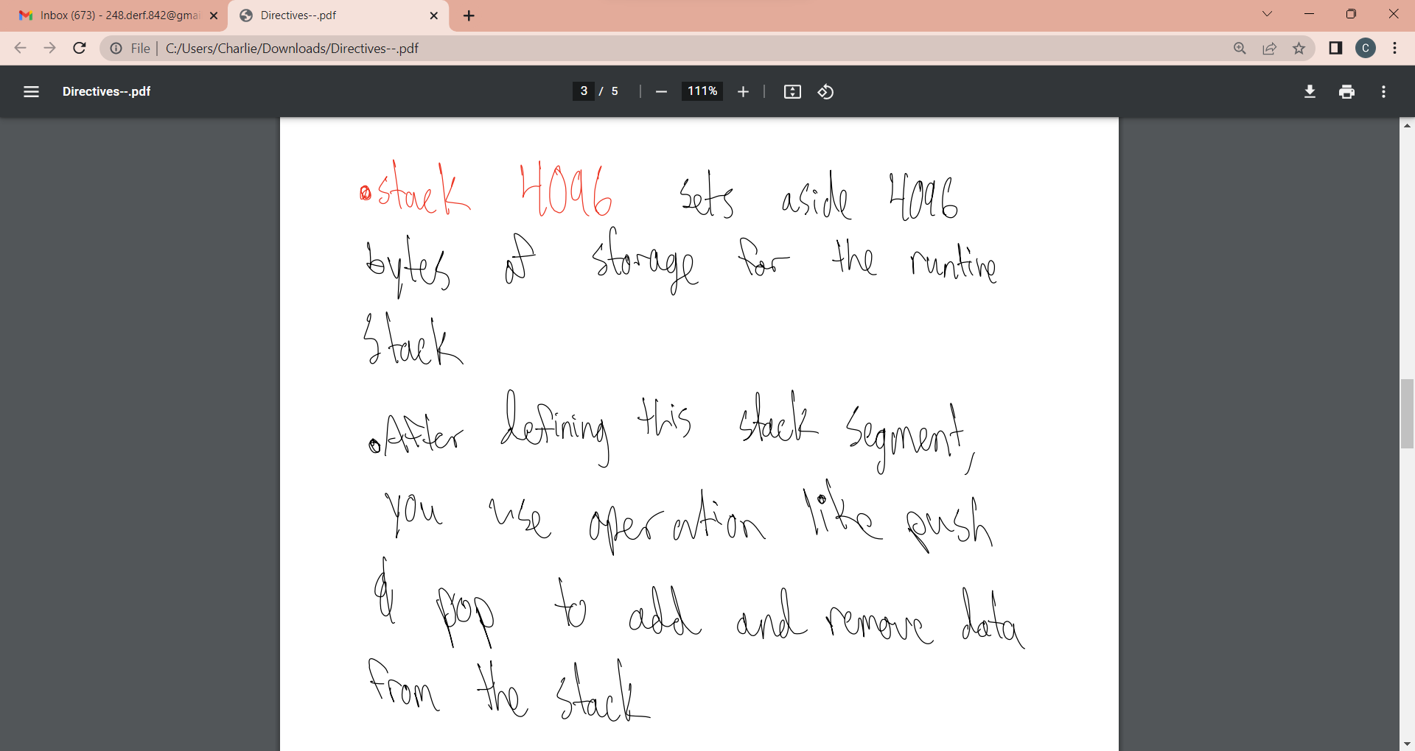

Slide 39
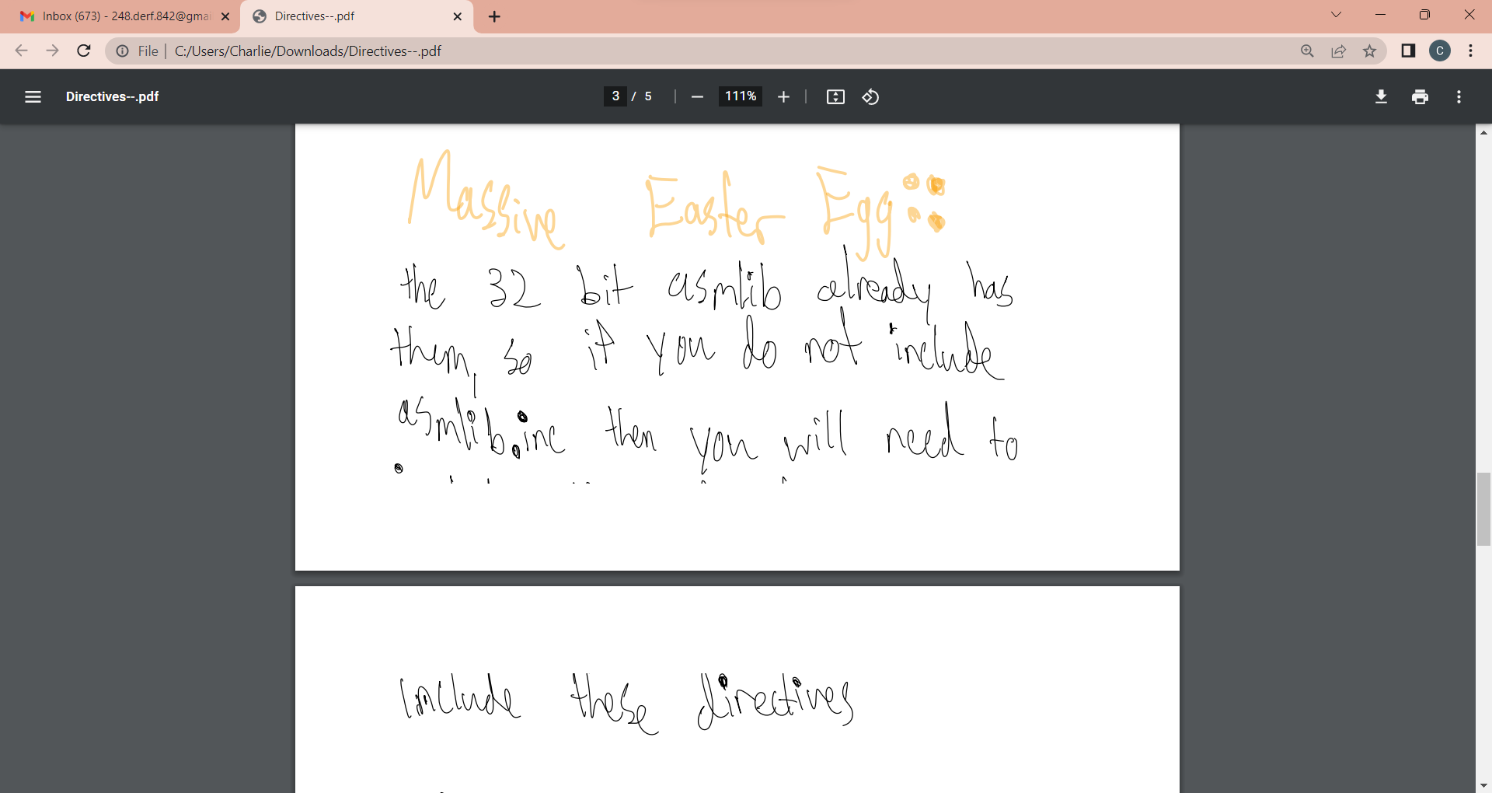

Slide 40
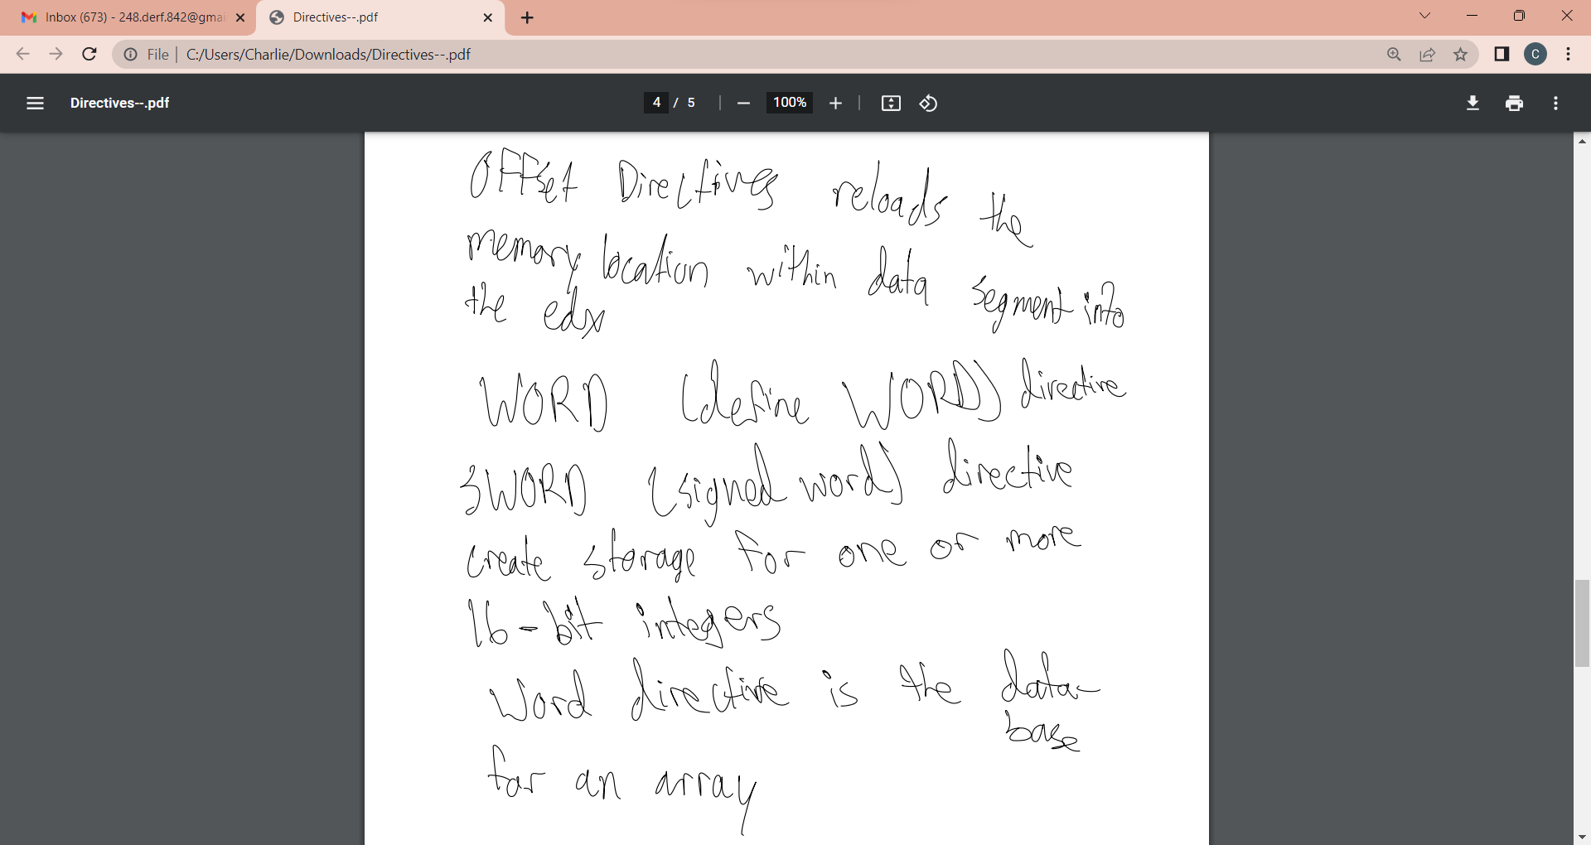

Slide 41
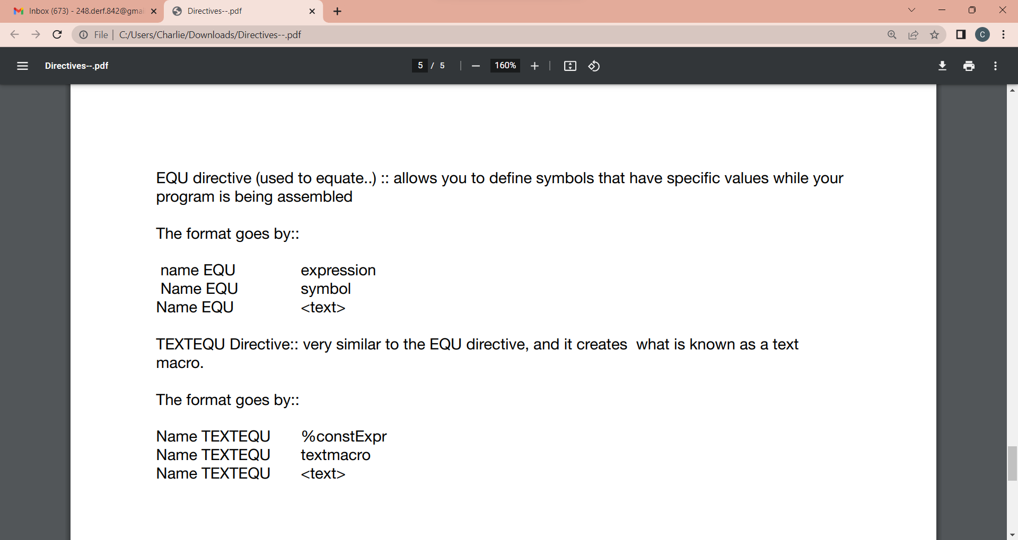

Slide 42


Slide 43
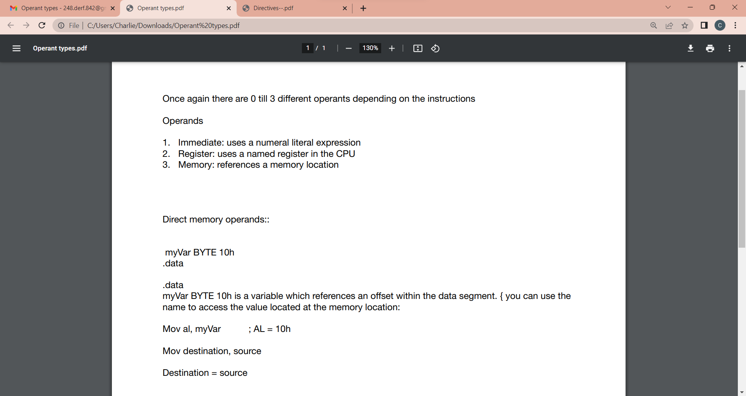

Slide 44
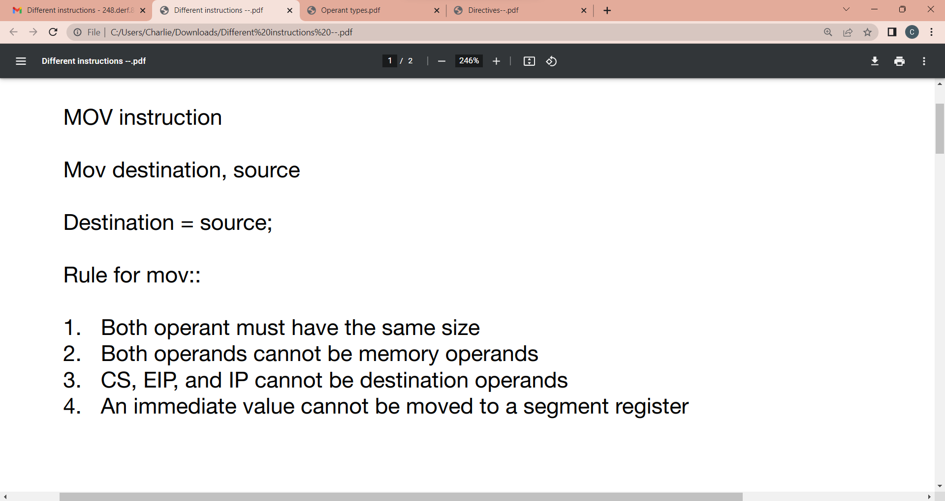
Different instructions

Slide 45
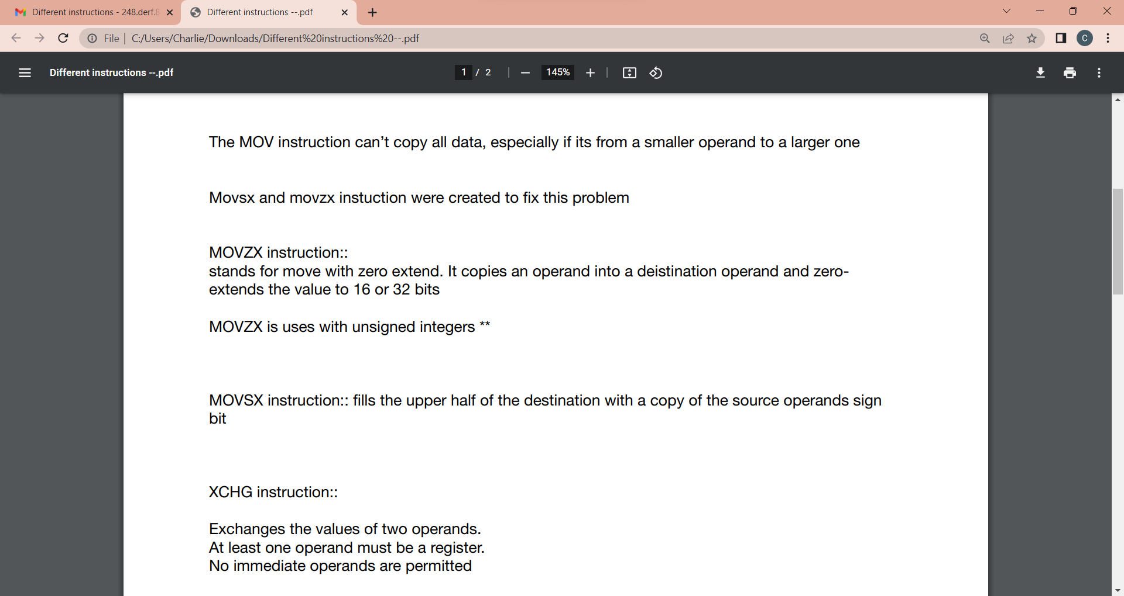

Slide 46
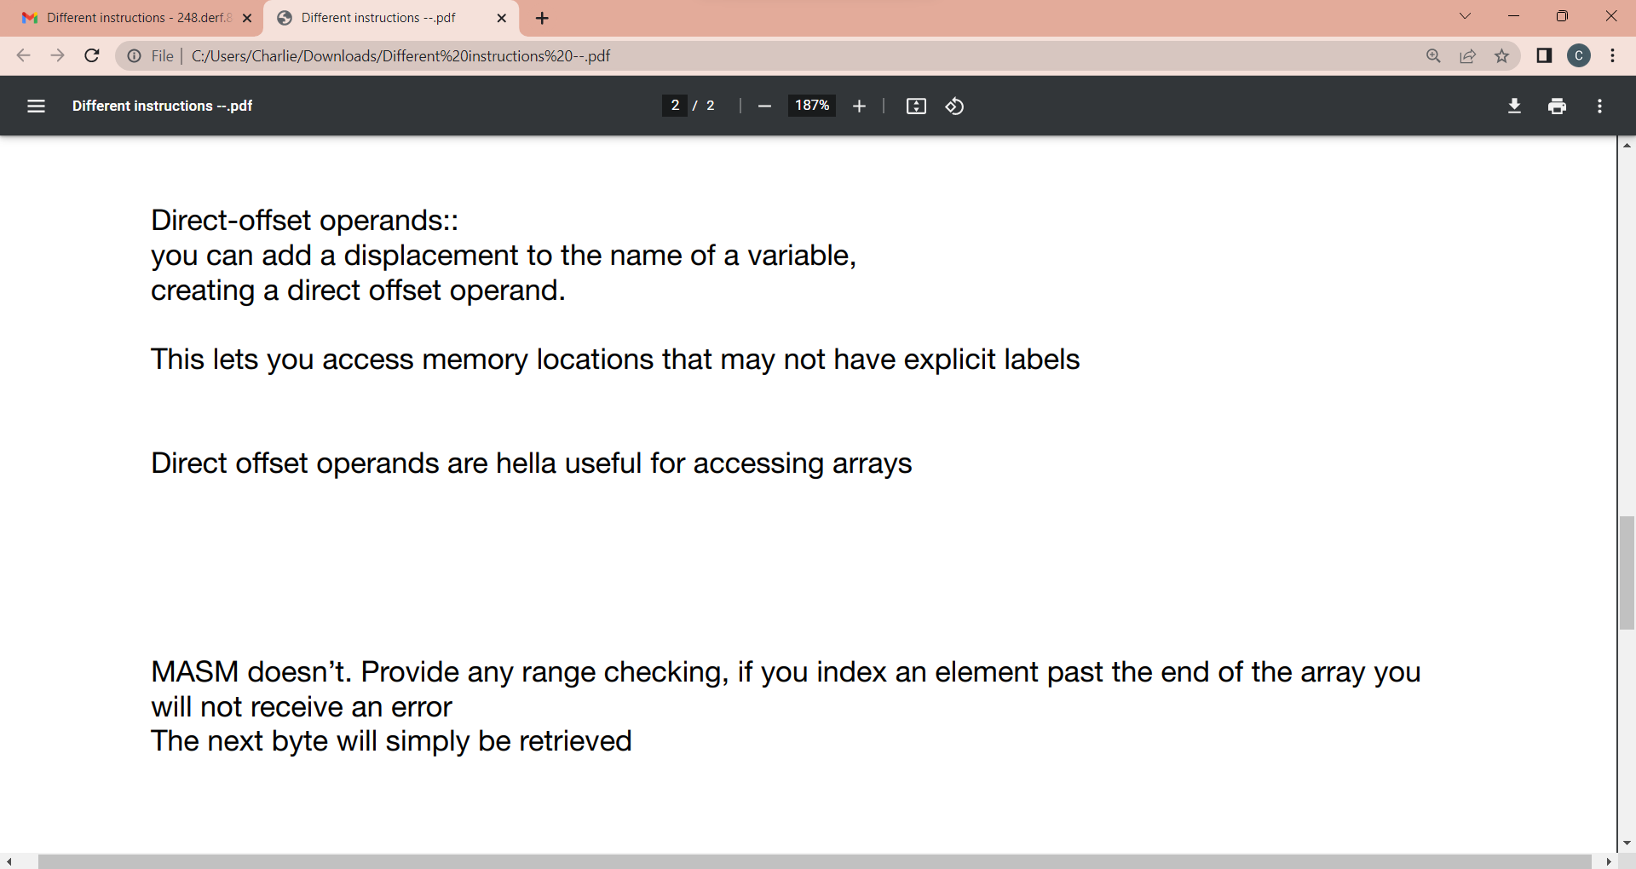

Slide 47
Arithmetic Operations

Slide 48
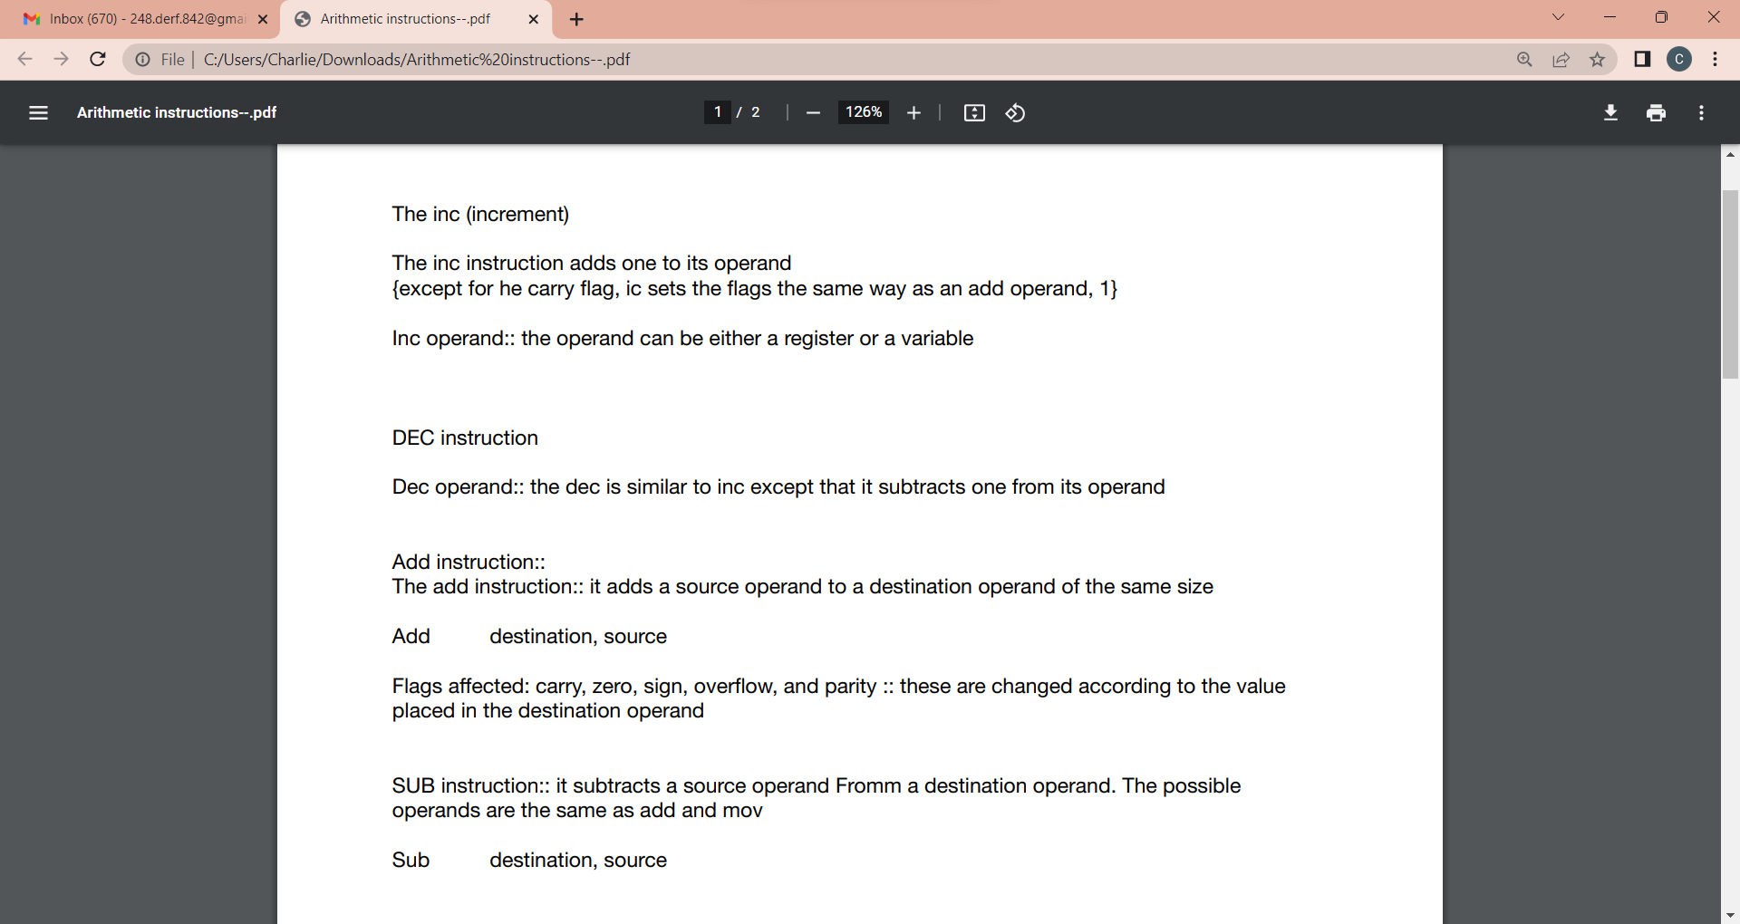

Slide 49
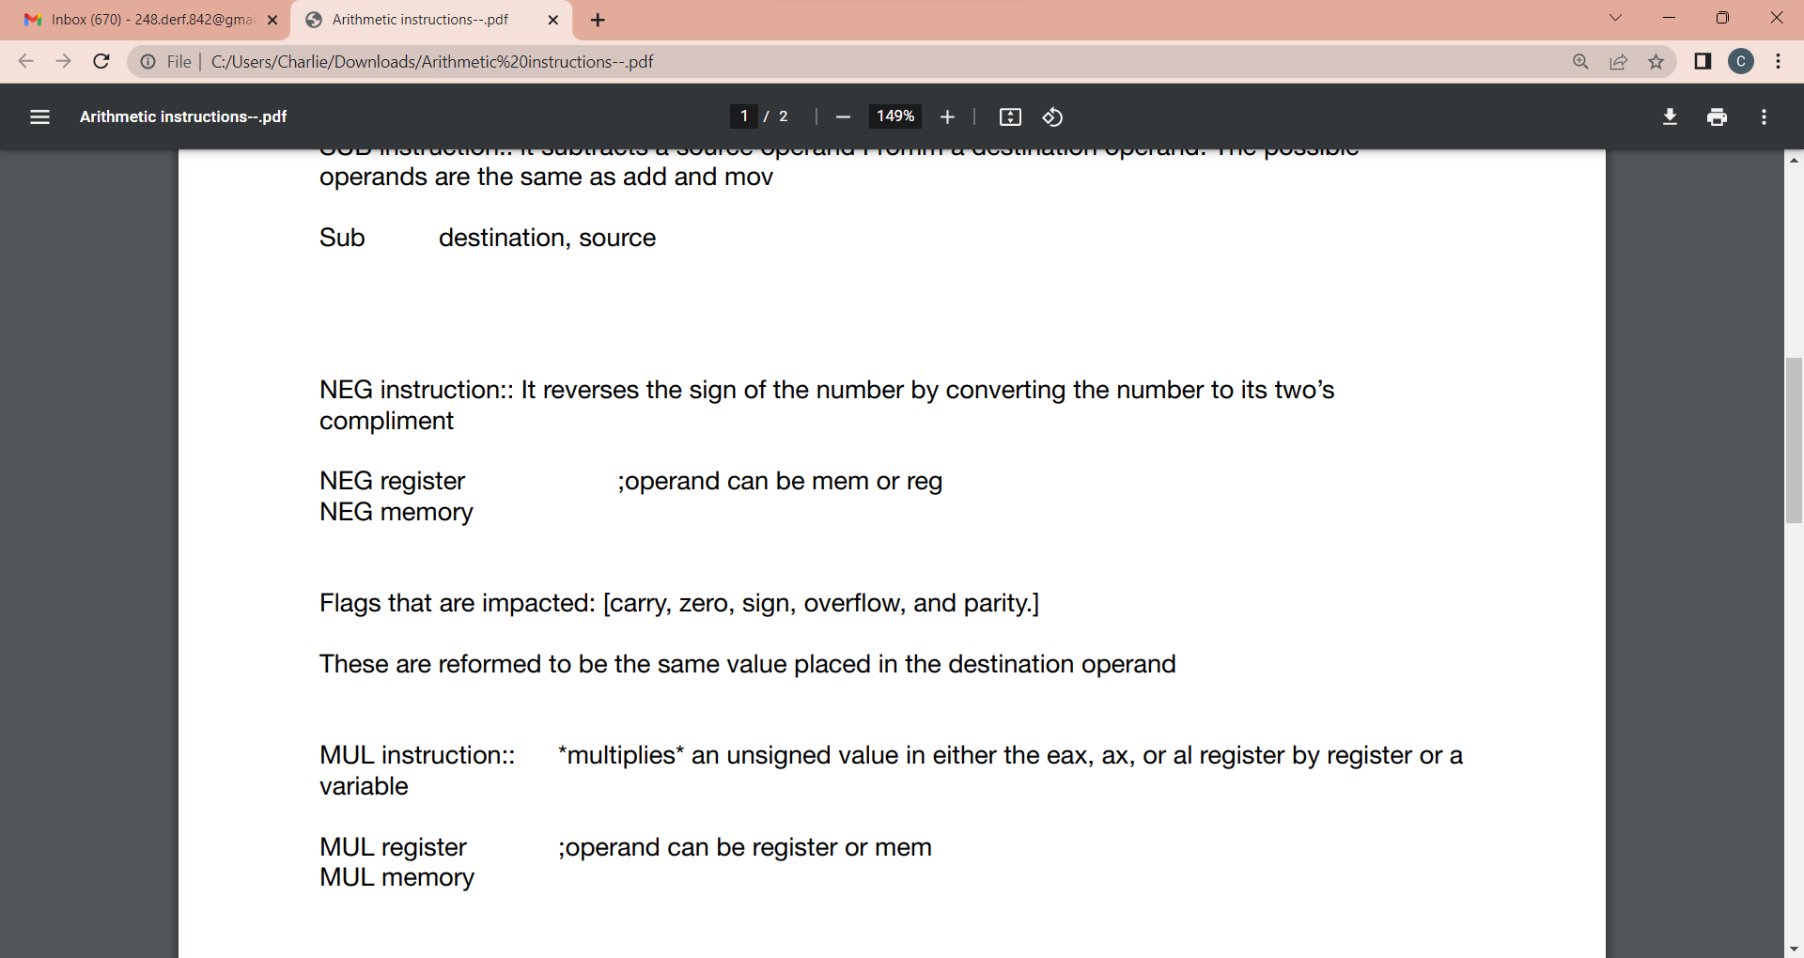

Slide 50
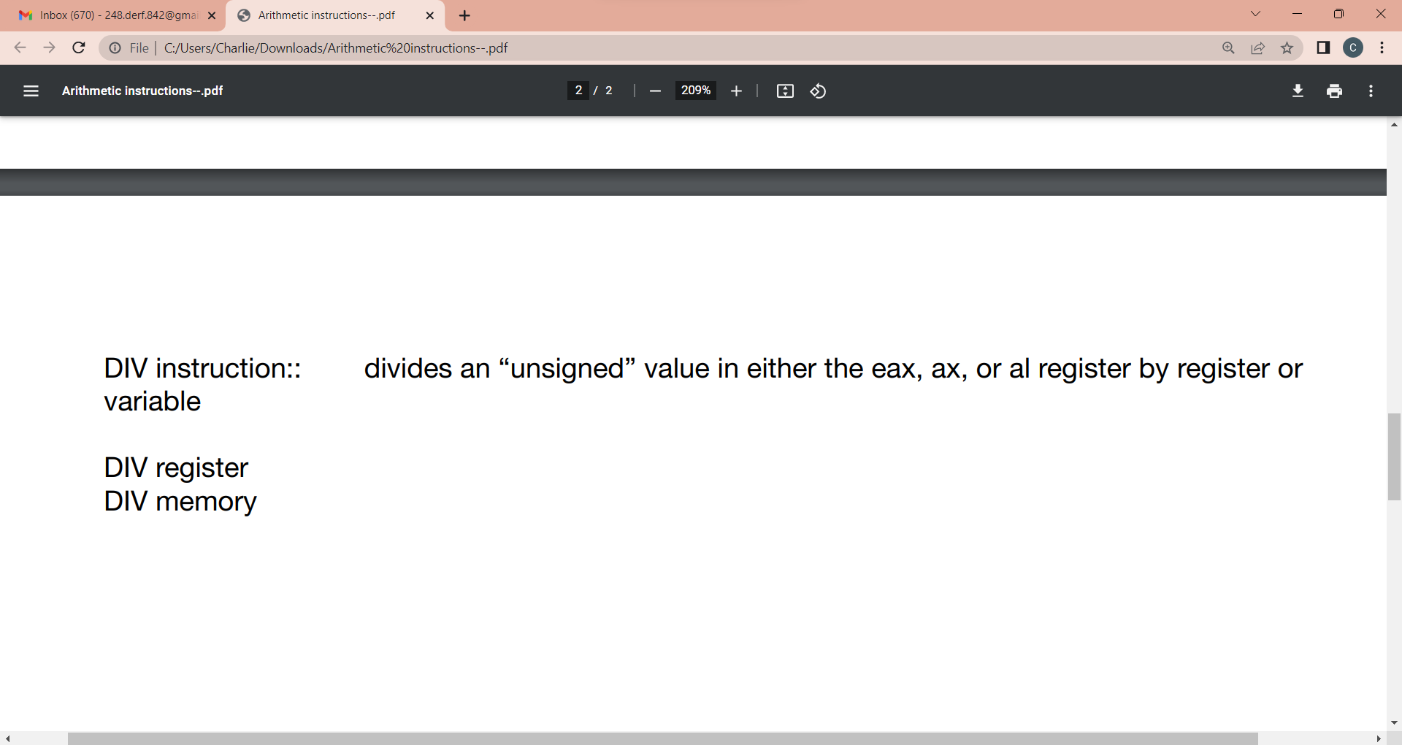

Slide 51


Slide 52
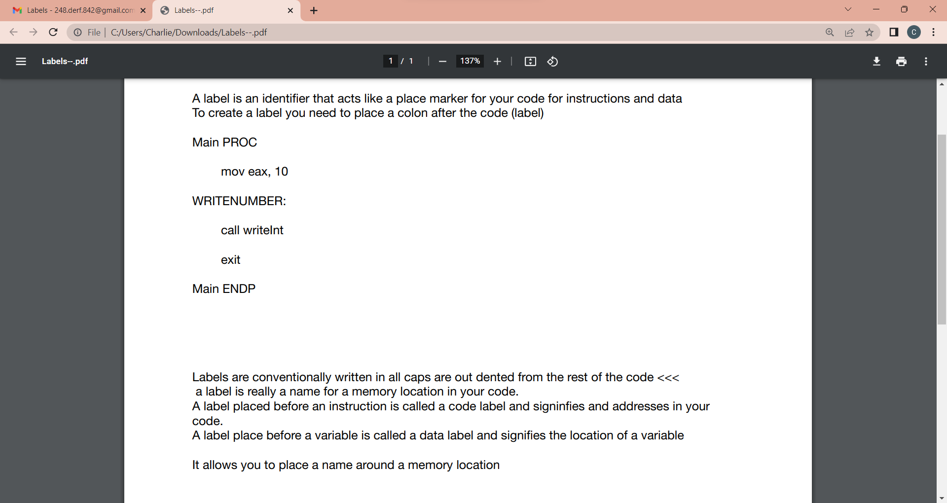
Labels

Slide 53
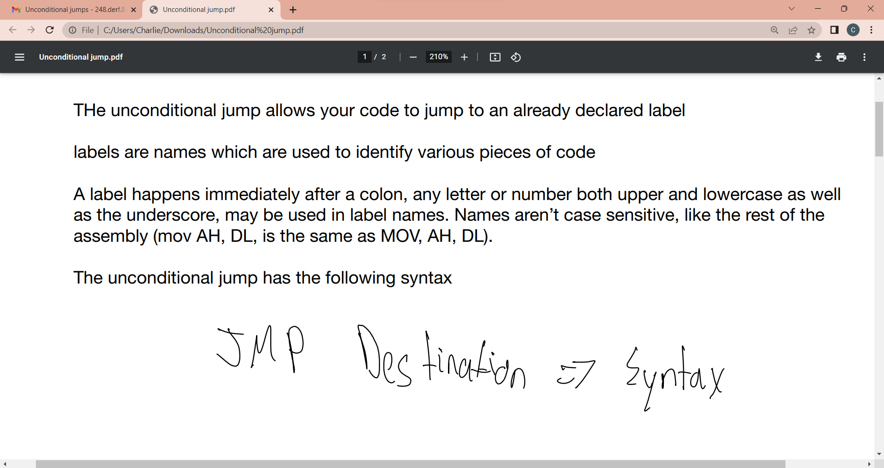
Unconditional Jumps

Slide 54
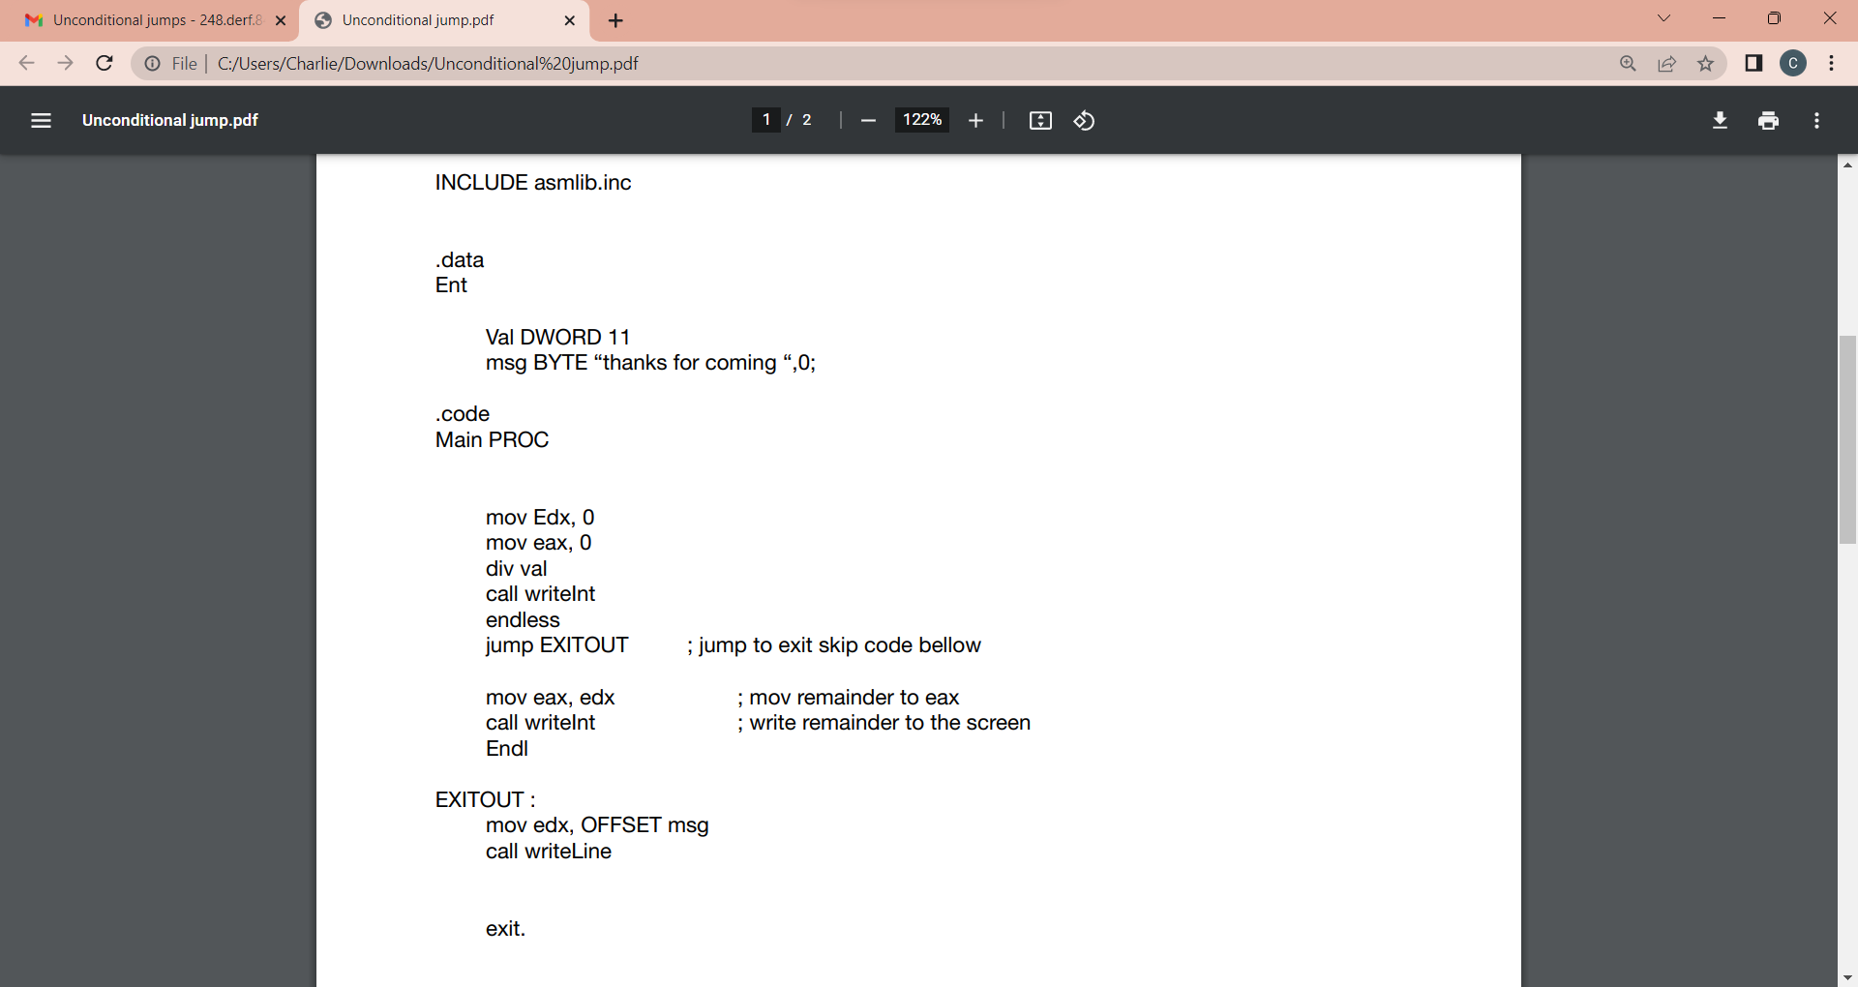

Slide 55
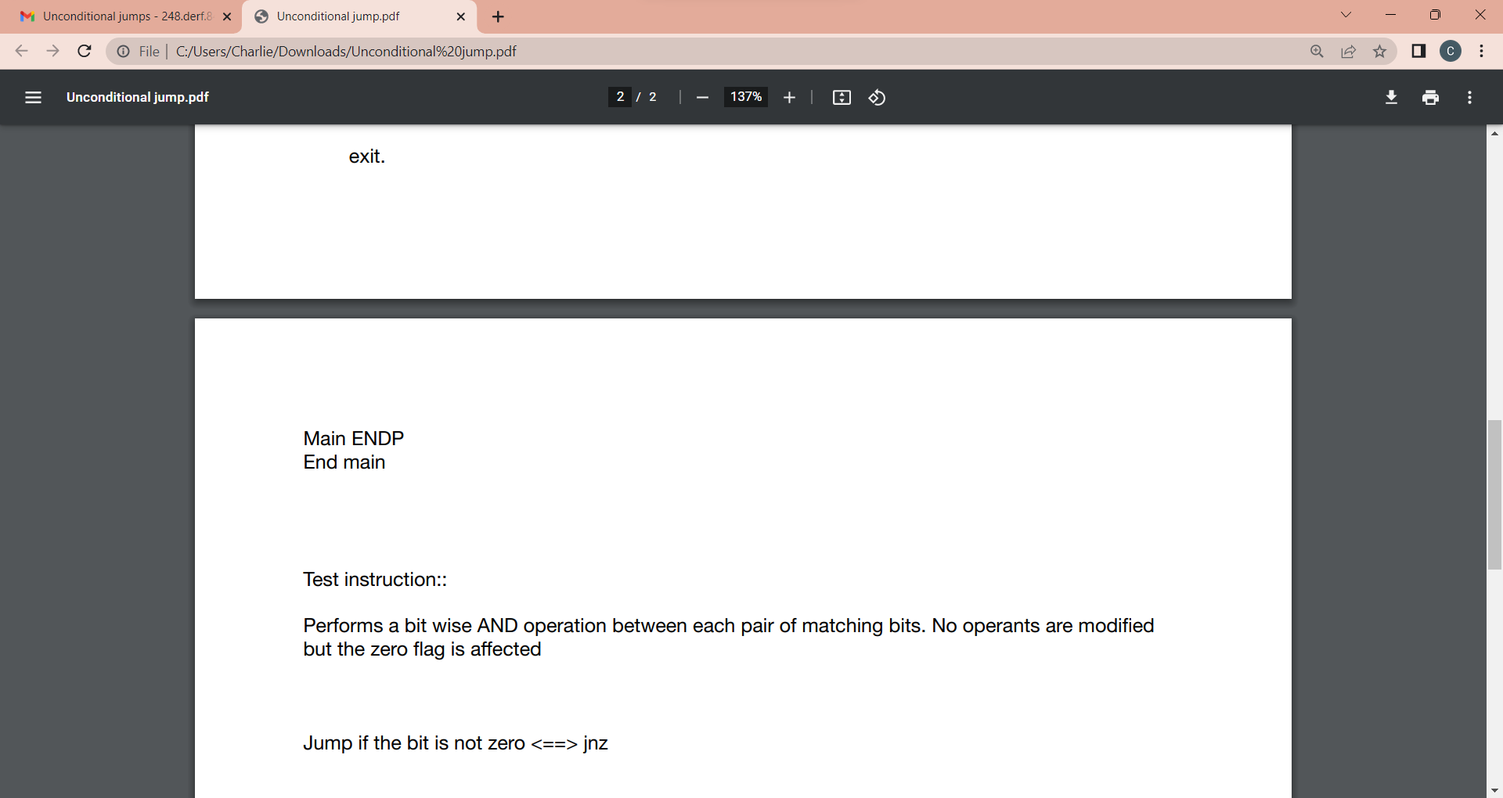

Slide 56
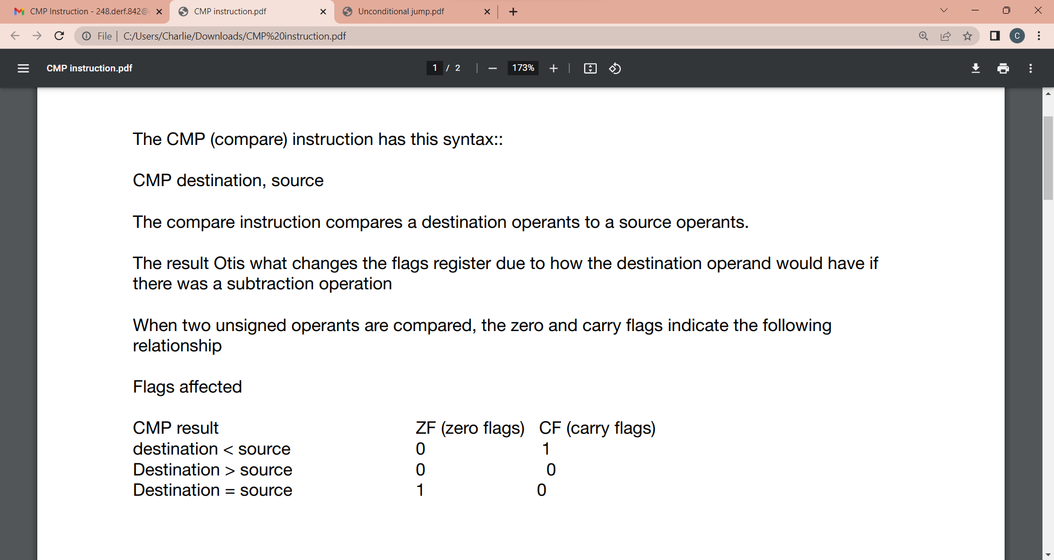
CMP Instructions

Slide 57
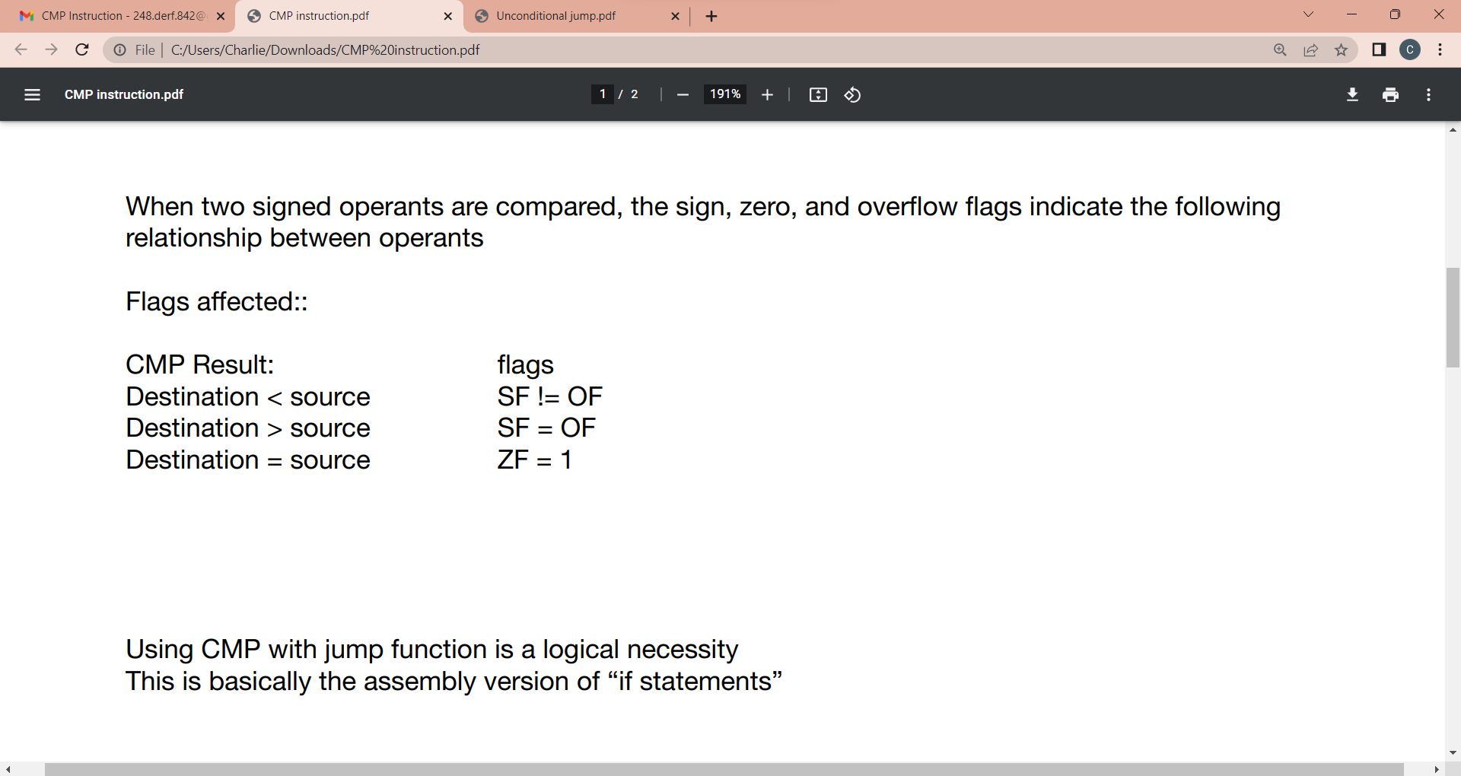

Slide 58

Conditional Jumps based on equality

Slide 59


Slide 60


Slide 61


Slide 62


Slide 63


Slide 64


Slide 65


Slide 66


Slide 67

Registers name and purpose

Slide 68


Slide 69


Slide 70

Boolean Operators (more practice with flags

Slide 71


Slide 72


Slide 73

Labels

Slide 75

Unconditional Jumps

Slide 76


Slide 77


Slide 78

Test Instructions

Slide 79


Slide 80

Compare Instructions

Slide 81


Slide 82


Slide 83

Flags

Slide 84


Slide 85


Slide 86

Conditional Jumps

Slide 87


Slide 88


Slide 89


Slide 90


Slide 91


Slide 92


Slide 93


Slide 94


Slide 95


Slide 96


Slide 97


Slide 99

Input procedures

Slide 100


Slide 101


